Slide 1

Trusting Our Instincts: Life-Saving Power of Keeping Mothers & Babies Together
Brooke Schaefer MBA, FNP-C, CARN-AP

Slide 2

Brooke Schaefer MBA, FNP-C, CARN-AP
Wife
Mother
Hippie
Eternal Extrovert Optimist
Former NICU Nurse
Certified infant loss counselor
Family Nurse Practitioner
Certified Addictions Registered Nurse – Advanced Practice
Masters of Business Administration – Health Care Focus
Stained glass artist
Have pet sheep and ponies

Slide 3
Ground Rules
good conversation
Interrupt
Be ready for a tangent
We don’t have to agree

Slide 4

The instinct to stay close isn’t just emotional — it’s biological, protective, and evidence-based

Slide 5

Notes:
Mama bear! If not friend, why friend shaped!!!??? Think she’s cute? Sure, but we all know in our hearts that it will not end well if you try to snuggle.

Slide 6

Notes:
Asian elephants.
When a baby is born, the whole herd circles around — shielding it until it can stand.
Older females — “allomothers” — help raise the young, ensuring no mother is alone.
Their instinct to protect isn’t hesitation — it’s immediate, unified, and unwavering.
Like elephants, we thrive when our systems surround mothers with safety, support, and connection.

Slide 7
But what If it isn’t that straightforward? The impact of early experiences
Obviously.
Notes:
In nature, mothers aren’t left alone — and babies aren’t left behind. But what happens when, for humans, that circle of care gets interrupted? When early experiences go from protective to painful?

Slide 8
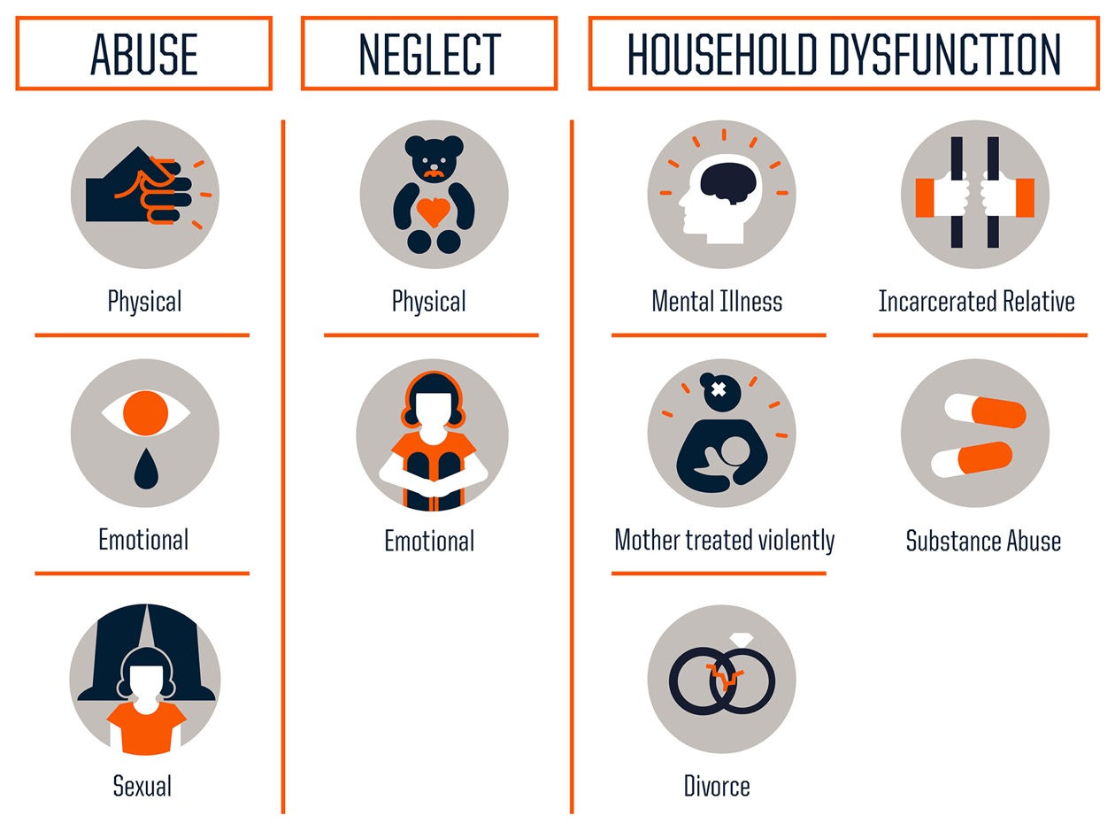
ACE Scores
https://www.cdc.gov/aces/about/index.html

Slide 9
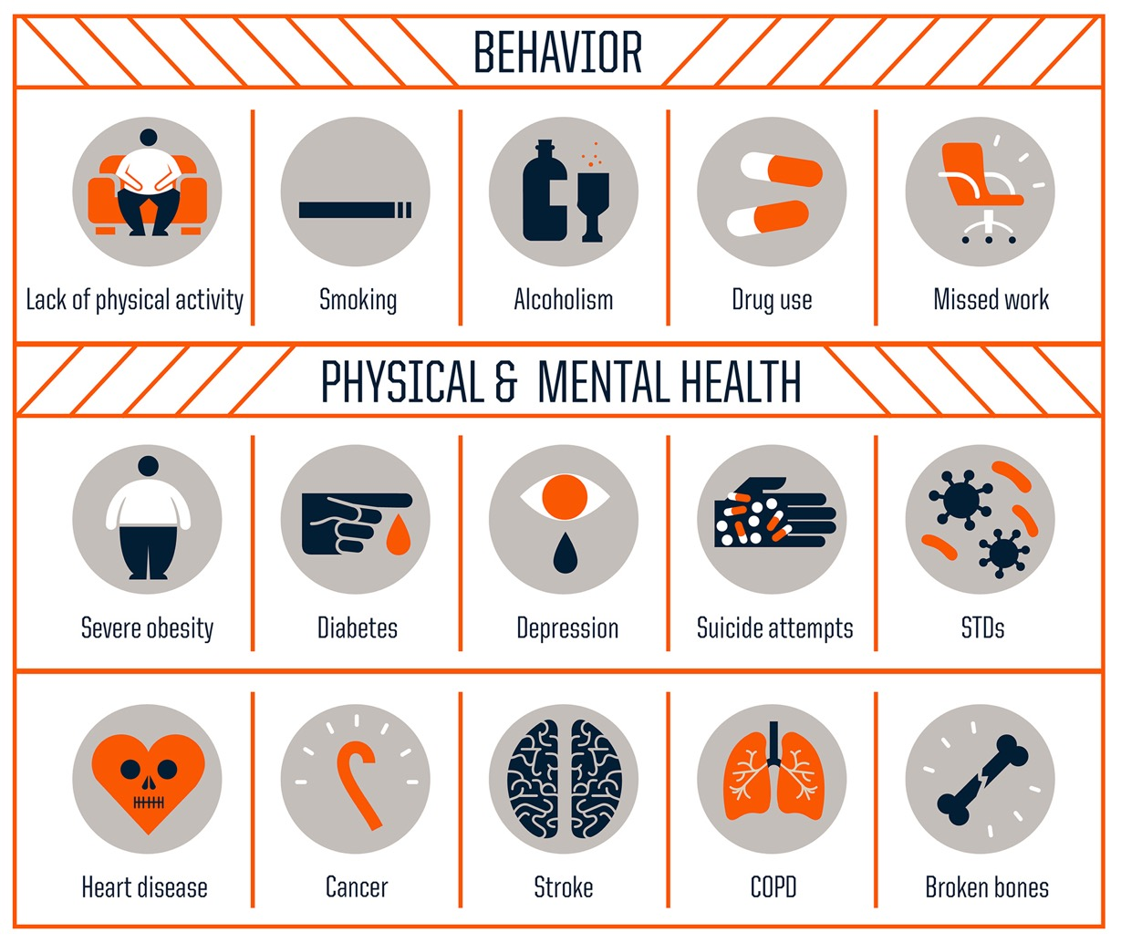
https://www.cdc.gov/aces/about/index.html
Notes:
he more ACEs someone has, the higher their risk for poor physical and mental health.
High ACE scores are linked to heart disease, cancer, addiction, depression, and early death.
These experiences disrupt how the brain and body handle stress — making everyday life feel like survival.
When we talk about mothers in recovery, we are often talking about women with high ACE scores — who were not protected when they needed it most.

Slide 10
Leading cause of maternal death?
Substance Use Disorder
Leading cause of child removal from their mother?
Notes:
Nationally, substance use is cited in more than 70% of child welfare cases involving infants. In some states, that number exceeds 80%.

Slide 11
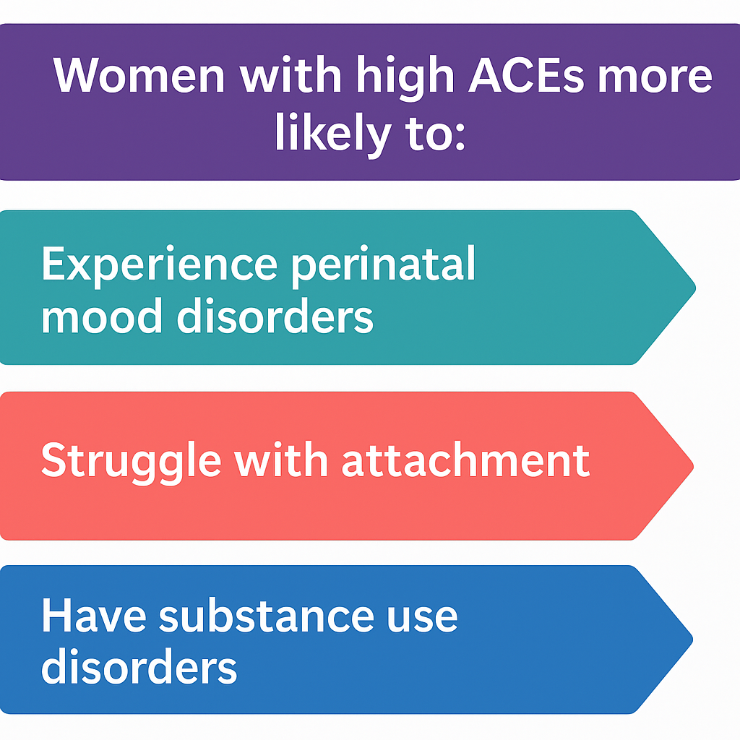
ACE Scores and Maternal outcomes
Notes:
Stat: One-third of pregnant women with opioid use disorder report ≥4 ACEs (McKelvey et al., 2020)
Reference: McKelvey, L. M., et al. (2020). Child Abuse & Neglect, 104, 104492.

Slide 12

Impact of Removal on Maternal Health
Emotional trauma of loss = higher rates of:
SUD relapse
Mental health crisis
Suicide attempts
Notes:
Mothers who lose custody are 3-5x more likely to relapse with substance use within 90 days (Werbel, 2016)
Reference: Kenny, K. S., et al. (2015). Qualitative Health Research, 25(9), 1272–1284.
Reference: Werbel, C. (2016). Journal of Social Work Practice in the Addictions, 16(4), 418–441.

Slide 13
Real life stigma.
“If you’re only protecting the mother, I’ll protect the baby.”
Notes:
I once had a colleague say to me, “If you’re only going to protect the mother, then I’ll have to protect the baby.” It was a powerful moment—and a painful one—because it revealed just how deeply stigma can cloud our thinking.
What she didn’t see was that when we support a mother’s healing, we’re not choosing her over the baby—we're protecting them both. Healing the mother reduces long-term risk for the child, lowers the chances of future trauma, and strengthens the entire family.
Helping moms recover means lowering ACE scores for the next generation. It means breaking cycles. It means a safer, more stable environment for children.
Of course we must always keep children safe from harm. But by walking alongside their mothers, by being part of their healing—not their punishment—we create a healthier world for both mother and baby.

Slide 14

What’s in it for the Baby?
Secure attachment = safety + regulation
Builds resilience against stress, trauma, and future risk
Disrupted attachment = higher ACE scores, higher risk of SUD

Slide 15

What if we can keep them together?
Notes:
WE HELP THEM BOTH.
We break the cycles
We change the world

Slide 16

Outcomes of Keeping Moms & Babies Together
Better maternal retention in treatment
Lower NOWS severity in infants
Higher breastfeeding rates
Less postpartum depression
Notes:
Stat: Infants kept with mothers have 63% shorter NAS treatment stays (Grossman, 2017)
Reference: Grossman, M. R., et al. (2017). Pediatrics, 139(6), e20163393.

Slide 17
Recovery together
Detox
Residential
Connection
Outpatient
Housing
Notes:
Detox mom
Keeping the mother is a safe environment with baby, or baby visiting frequently
Close connection to nurses that link clients to medical, OB, peds, therapy, peer coaches, etc
Seamless transition to outpatient
SAFE and affordable housing

Slide 18
Active Use
Sober
Seeking Housing
Denied
Depression
Notes:
Client did the work to get sober
DCS wouldn’t close the case with her kids until she had housing
She couldn’t get housing
Had a prior felony and a prior eviction
Spent a YEAR paying back her prior eviction to get if removed
Finally got a house after TWO years of sobriety

Slide 19
If we see something we must do something

Slide 20

Supportive Housing
One year of level 3 residential support
Partnered with longer term apartments, up to two years
On site day care, behavioral health clinic, free clinic (medical, dental, vision)
Notes:
This gives time to work on the details that will allow for permanent

Slide 21

Optimism

Slide 22
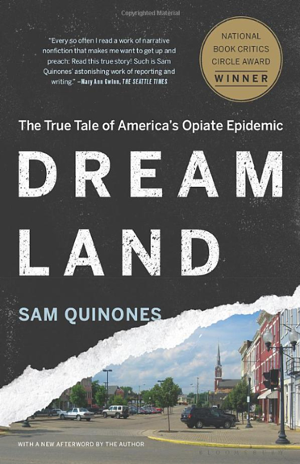
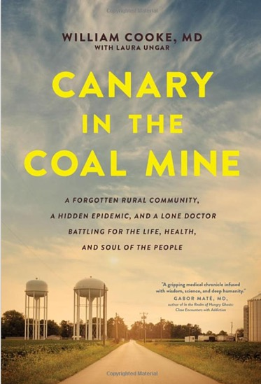

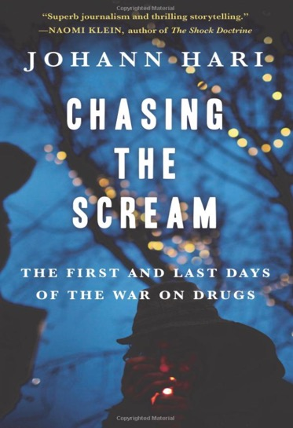
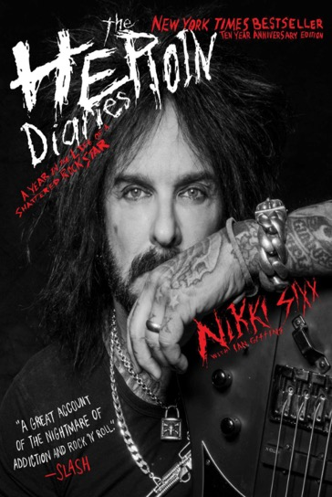
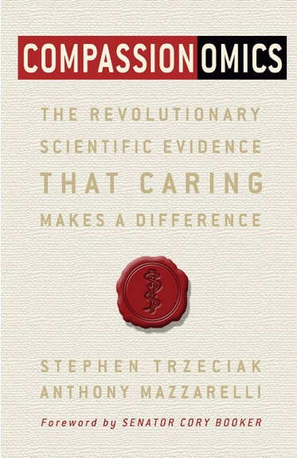
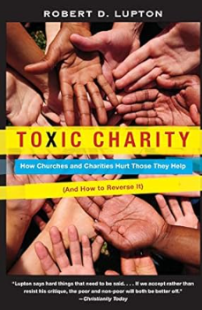

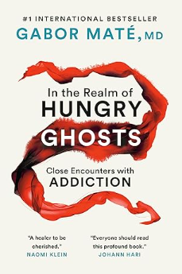
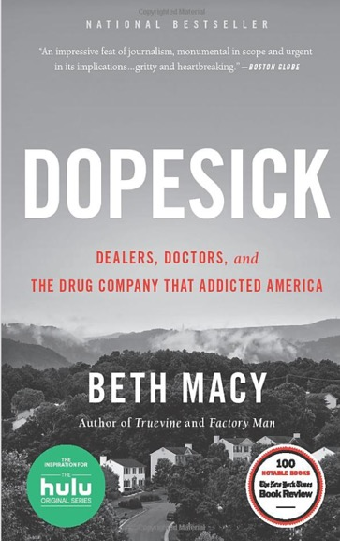

Slide 23

Brooke Schaefer
Brooke.Schaefer@voaohin.org
765-336-9700

Slide 24
American Psychiatric Association. (2013). Diagnostic and statistical manual of mental disorders (5th ed.). https://doi.org/10.1176/appi.books.9780890425596
Felitti, V. J., Anda, R. F., Nordenberg, D., Williamson, D. F., Spitz, A. M., Edwards, V., ... & Marks, J. S. (1998). Relationship of childhood abuse and household dysfunction to many of the leading causes of death in adults: The Adverse Childhood Experiences (ACE) Study. American Journal of Preventive Medicine, 14(4), 245–258. https://doi.org/10.1016/S0749-3797(98)00017-8
Grossman, M. R., Berkwitt, A. K., Osborn, R. R., Xu, Y., Esserman, D. A., Shapiro, E. D., & Bizzarro, M. J. (2017). An initiative to improve the quality of care of infants with neonatal abstinence syndrome. Pediatrics, 139(6), e20163393. https://doi.org/10.1542/peds.2016-3393
Hari, J. (2015). Chasing the scream: The first and last days of the war on drugs. Bloomsbury Publishing.
Jansson, L. M., Velez, M., & Harrow, C. (2008). The opioid-exposed newborn: Assessment and pharmacologic management. Pediatrics, 121(1), e106–e114. https://doi.org/10.1542/peds.2006-3127
Kenny, K. S., Barrington, C., & Green, S. L. (2015). “I felt for a long time like everything beautiful in me had been taken out”: Women’s suffering, remembering, and survival following the loss of child custody. Qualitative Health Research, 25(9), 1272–1284. https://doi.org/10.1177/1049732314553665
McKelvey, L. M., Edge, N. A., Mesman, G. R., Whiteside-Mansell, L., & Bradley, R. H. (2020). Adverse childhood experiences in children with and without autism spectrum disorder. Child Abuse & Neglect, 104, 104492. https://doi.org/10.1016/j.chiabu.2020.104492
McKenna, M. F., Heneghan, A., & Tully, K. P. (2021). Home visiting for families affected by substance use: A review of programs and promising practices. Maternal and Child Health Journal, 25(3), 375–383. https://doi.org/10.1007/s10995-020-03059-6
Substance Abuse and Mental Health Services Administration (SAMHSA). (2023). Key substance use and mental health indicators in the United States: Results from the 2022 National Survey on Drug Use and Health (NSDUH). https://www.samhsa.gov/data/report/2022-nsduh-annual-national-report
Thomas, S., Marlow, S., & Brunton, G. (2021). Stigma and unmet needs of mothers with substance use disorders: A literature review. Addiction Research & Theory, 29(1), 1–8. https://doi.org/10.1080/16066359.2020.1779106
Werbel, C. (2016). Women and addiction: A trauma-informed approach. Journal of Social Work Practice in the Addictions, 16(4), 418–441. https://doi.org/10.1080/1533256X.2016.1235429

