Slide 1
High Risk Pregnancy and Low Birth Weight
Lauren Dungy-Poythress
Maternal Fetal Medicine Specialist
Indiana University School of Medicine

Slide 2

Objectives
Discuss
Definition of preterm birth and low birth weight
Discuss
Pregnancy factors associated with preterm birth and low birth weight infants
Discuss
Neonatal management and concerns of preterm and low birth weight infants

Slide 3
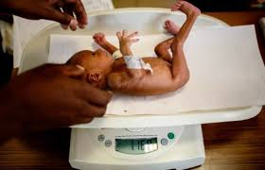
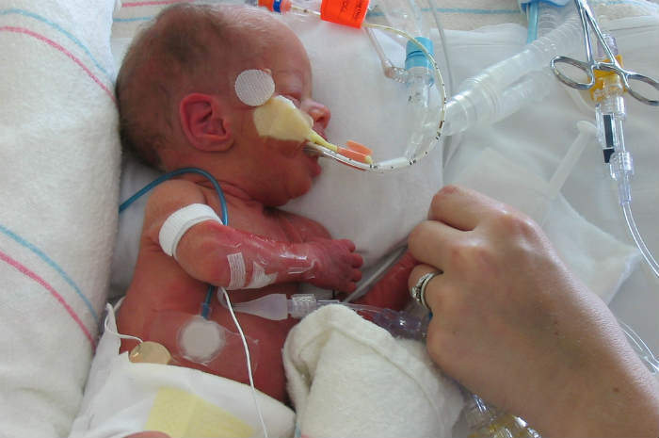
Not the same - Not exclusive
Premature Infant
Low Birth Weight
Born before the 37th week
of pregnancy
Fetal weight
< 2500 g (5 lbs 8 oz)
Primarily caused by premature birth

Slide 4
Factors Associated with Prematurity and Low Birth Weight
Prior history of premature birth or low birth weight
Hypertensive disease of pregnancy (HDP)
Preexisting health conditions (e.g., SLE, DM, Anemia)
Smoking/Substance Abuse
Placental problems (e.g., placenta previa, abruption)
Multiple gestation
Maternal age (< 16 or > 35)
Race/ethnicity
Lack of prenatal care
Socioeconomic status
Infection
Stress

Slide 5

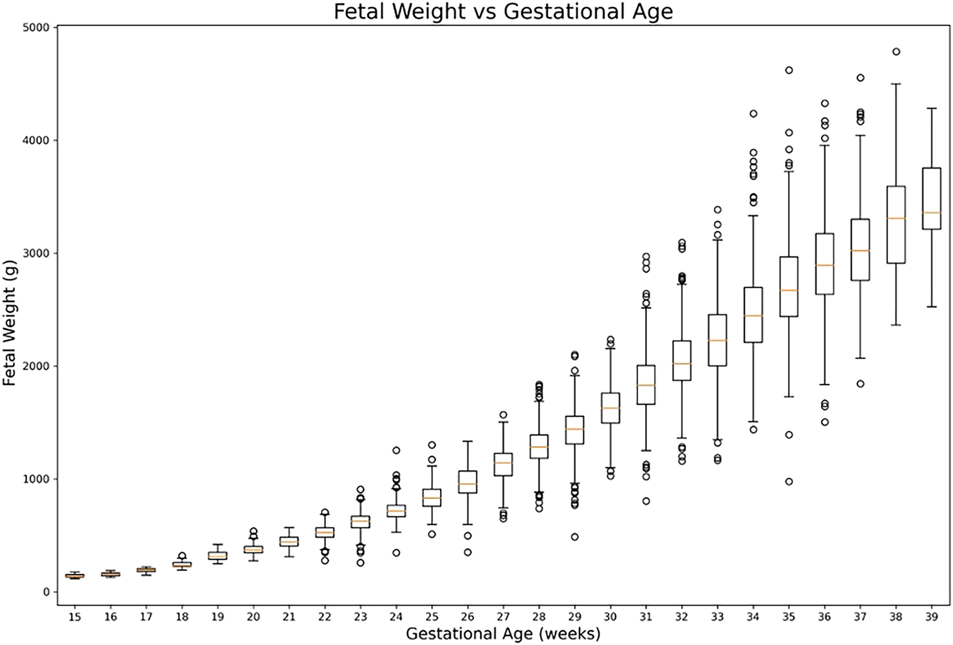
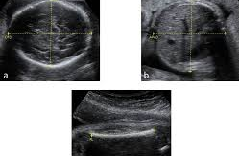
Estimated fetal weight
Sonographic estimation in pregnancy
EFW < 10th percentile - FGR
EFW < 3rd percentile - severe FGR
Earlier onset more concerning
Less accuracy in EFW later pregnancy

Slide 6
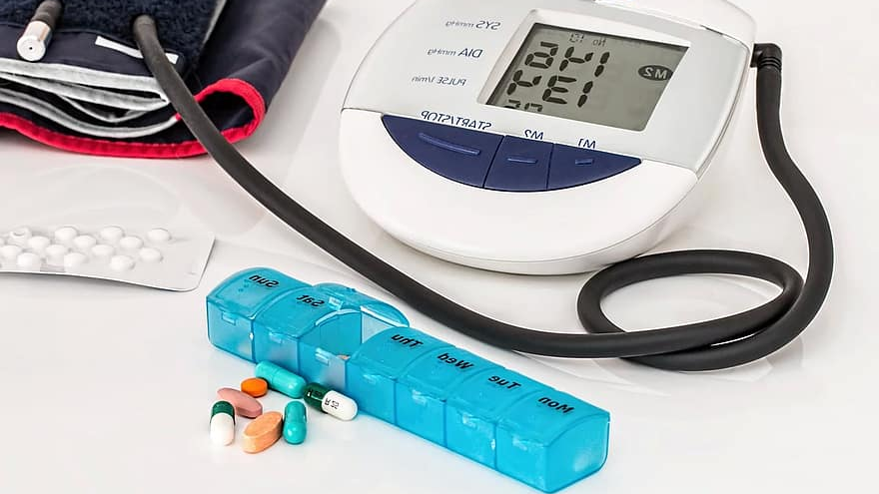
Hypertensive Disease in pregnancy (HDP)
Underlying HTN
HTN before pregnancy or < 20 weeks’ gestation
BP > 140/90 mmHg in pregnancy
Gestational HTN
Hypertension occurring after 20 weeks’ gestation without proteinuria
Preeclampsia
HTN and proteinuria (> 300 mg/24 hr; P/C > 0.3) and/or end-organ dysfunction
Severe and non-severe forms

Slide 7

Hypertension
American College of Cardiology (ACC)
&
American Heart Association (AHA)
Classification
Normal < 120/80 mm Hg
Elevated – 120-129/80 mmHg
Stage I HTN – 130-139/80-89 mmHg
Stage II HTN – 140/90 mmHg or more
*ACOG still utilizes 140/90 mmHg definition for HTN

Slide 8

Cigarette Smoking
Cigarette smoking
Well over 4000 different chemicals identified in cigarette smoke
Carbon monoxide and nicotine are 2 concerning compounds
Associated with LBW and placental abruption
Maternal risks
Cancer (throat, lung, cervical, skin)
Lung disease
Placental abruption
Fetal risks
LBW
Placental abruption
Neonatal risks
SIDS
Lung disease

Slide 9


Vaping
No regulation of contents
VALI–
Vaping
Associated
Lung
Injury

Slide 10


Marijuana
American College of OB/Gyn
Children whose mothers used marijuana during pregnancy may have learning and behavioral problems later in life
American Cardiology Association
Recent data links marijuana use to cardiovascular disease which is dose dependent similar to cigarette smoking

Slide 11
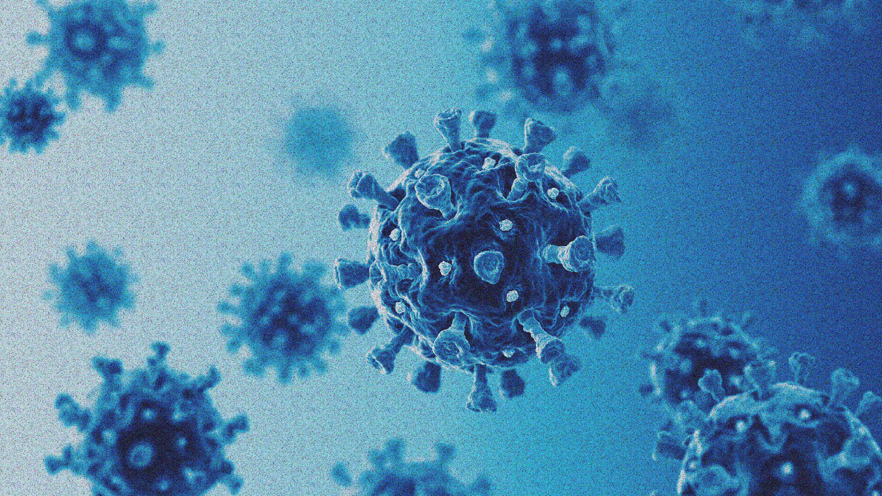
Infection
Infection can lead to a cascade of of events lead to preterm labor
Inflammation leads to prostaglandin release
Examples:
Chorioamnionitis
Urinary tract infection
Flu, Measles, Polio, Varicella
STD (e.g., syphilis)

Slide 12
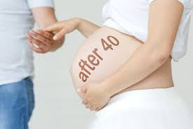
Advanced Maternal Age
Defined as age 35 years or older
Association with LBW not soley based on age
Other factors play a role
(e.g., medical health, SES, ART)

Slide 13
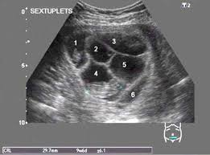
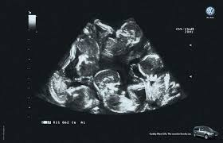

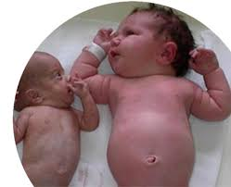
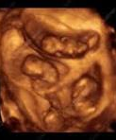
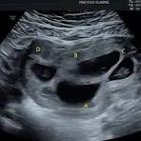

Multiple gestation

Slide 14

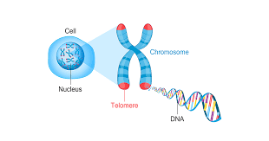
Weathering
Chronic stress can lead to pregnancy complications

Slide 15
High Risk Pregnancy and Low Birth Weight
Lauren Dungy-Poythress
Maternal Fetal Medicine Specialist
Indiana University School of Medicine

