Slide 1
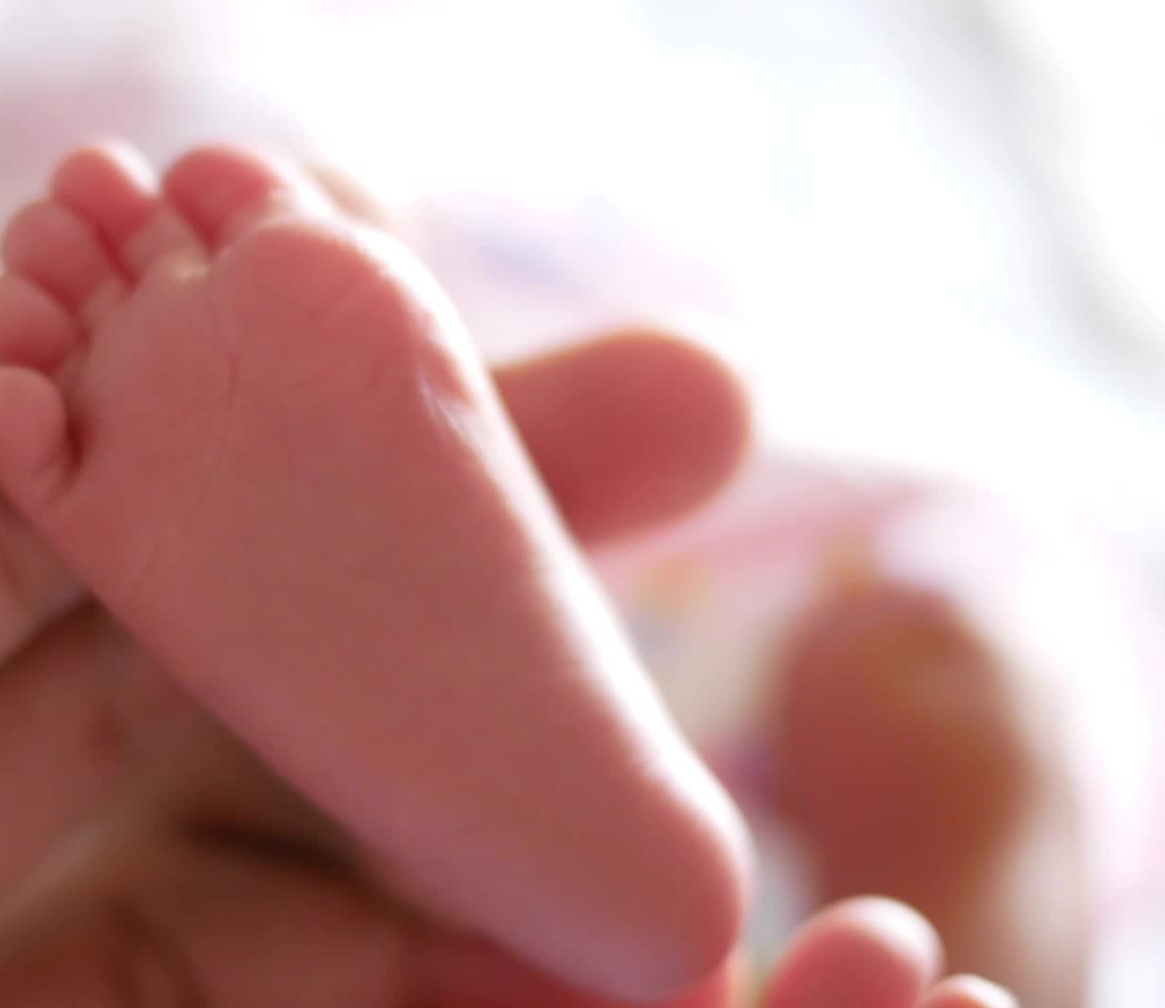
LOW BIRTH WEIGHT INFANTS
Realize and Revitalize:
Embracing Maternal and Child Health
June 25, 2025

Slide 2
Objectives
Identify managements for Newborn Low Birth Weight (LBW) infants
Discuss needs for LBW infants following birth
Discuss discharge planning needs for LBW infants

Slide 3
Definitions

Slide 4
BIRTH WEIGHT DESCRIPTORS
Low Birth Weight (LBW)
Birth weight less than 2500g
Very Low Birth Weight (VLBW)
Birth weight less than 1500g
Extremely Low Birth Weight (ELBW)
Birth weight less than 1000g

Slide 5
GESTATIONAL AGE ASSESSMENT
Preterm: <37 wks
Late Preterm (formerly Near Term): 34-36 6/7 wks
Early Term: 37-38 wks
Term: 39-41 wks
Post Term: >41 wks
Notes:
In other words, weeks of gestation→GA

Slide 6
GROWTH ASSESSMENTS
Using Birth Weight:
Large for Gestational Age (LGA)
Greater than 90% tile
Appropriate for Gestational Age (AGA)
10-90% tile
Small for Gestational Age (SGA)
Less than 10% tile
Using Fetal growth:
Intrauterine Growth Restriction/Fetal Growth Restriction (IUGR/FGR)
Growth velocity starting at 22 wks gestation with subsequent decline

Slide 7
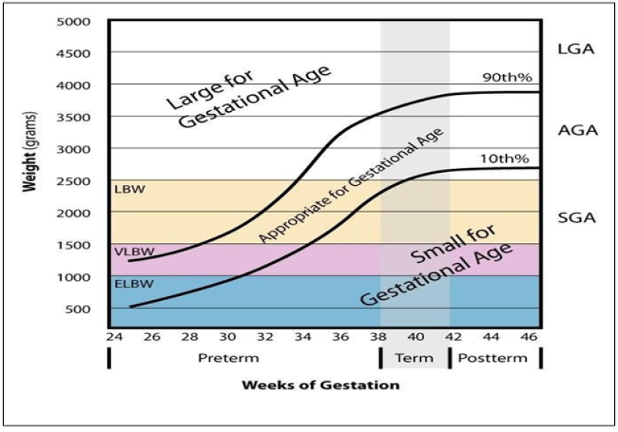
Newborn Assessments
Table

Slide 8
LOW BIRTH WEIGHT (LBW)
Results from prematurity, growth restriction or combination of both
In the United States, the majority of LBW infants are premature
Late preterm infants account for almost three quarters of preterm births
Late preterm infants have significant in-hospital morbidity and a three to five fold higher mortality rate compared with term infants
Coupled with prematurity, LBW represents a leading cause of infant mortality in Indiana
Notes:
Late preterm:34-36 6/7 wks

Slide 9
Managements

Slide 10
INITIAL MANAGEMENTS
At delivery
Neonatal Resuscitation and Stabilization
Initial physical exam
Growth assessments
Initiation of family centered care
LBW infant specifics:
Golden Hour (postnatal stabilization)
Skin to skin positioning
Notes:
Golden Hour: postnatal stabilization for high risk newborns. Focuses on respiratory, circulatory and thermal transitions as well as sudden interruption of nutrient supply from placenta. Concern in particular for avoidance of hypothermia, hypoglycemia, and infection. Tribolet article (Meta-analysis)-reduction in hypothermia, increased temp noted; lower rate of IVH, trend toward decreased BPD; time to surfactant adm reduced.

Slide 11
NEWBORN NURSERY and NICU CARE
Following delivery →Admission location
Monitoring
Identification of specific system issues (maternal history, delivery issues)
Nutritional/Feeding plan (breast feeding/milk/formula considerations)
LBW infant specifics:
Increased insensible water loss/thermoregulation
Respiratory* support needs (supplemental support, monitoring for “events”)
Nutritional* support (oral motor feeding skills, caloric needs)
Need for “catch up growth”
Risk for neurodevelopmental* issues
Potential for acute and chronic illness
Notes:
Monitoring: VS checks vs Cardio resp monitor.
Maternal history: serologies/infection;
Delivery issue examples-difficult, breech presentation

Slide 12
DISCHARGE PLANNING
Safe sleep modeling
Completion of mandatory NB screens (IDOH requirements)
Establishment of and support for feeding plans
Family participation in daily care
“Rooming in”
Scheduled PCP appointment, 1-2 days post discharge
LBW infant specifics:
Family Care conferences
Car Seat Study
Developmental assessments
Notes:
CSS if <37 wks and/or <2500g
Family care conference: daily care/managements; expected trajectory for infant; discharge planning needs

Slide 13
OUTPATIENT FOLLOW UP
Recommended healthcare follow up timing
Nutrition
Developmental Follow Up
Established caregiver engagement
LBW infant specifics
Corrected Gestational Age
Catch up Growth
Developmental Follow up (First Steps, NICU F/up Clinics)

Slide 14
TAKE HOME POINTS
Low Birth Weight infants require specialized care starting immediately after delivery.
These managements are based on Gestational Age (GA), appropriateness of birth weight in relation to GA and recognition of system specific issues.
Care for these infants must consistently include education and updates for caregivers (parents, extended family, adoption and fostering).
Caregivers require support.

Slide 15
Thank you!
Jo Ann Matory, MD
jmatory@iu.edu

