Slide 1
Realize and Revitalize: Embracing Maternal and Child Health
EDEN BEZY, MPH
ASSISTANT COMMISSIONER WOMEN, CHILDREN & FAMILIES
6/25/2025

Slide 3
Agenda
Share quantitative data related to infants, children, adolescents, women, and mothers
Share qualitative data gathered from families across Indiana
Identify priorities for prevention and intervention
Highlight resources and strategies from IDOH and our partners

Slide 4

Infant mortality and birth outcomes

Slide 5
Infant mortality quick facts
Infant Mortality is defined as the death of a baby before his/her first birthday.
Infant Mortality Rate is an estimate of the number of infant deaths for every 1,000 live births.
Infant Mortality is the #1 indicator of health status in the world.
Notes:
The cost of infant mortality in the U.S. is estimated to be around $12 billion annually
$7.4 billion in medical costs
$4.8 billion in lost productivity due to associated disabilities in survivors
Infant mortality is the No. 1 indicator of health in the world
10.9% are preterm, medical care ~$44,000 = $383.7 million

Slide 6
Data details
2023 infant mortality by the numbers
Based on death records from 2023
These deaths encompass births that could have taken place in 2022 or 2023.
These deaths encompass pregnancies that could have taken place from 2021-2023.
Infant mortality is calculated by taking the number of infant deaths divided by the number of live births for a given calendar year.
Both birth and infant death records are reported to the Indiana Department of Health Vital Records Division.
These data are based on residency rather than location of occurrence.
Source: Indiana Department of Health, Family Health Data and Fatality Prevention Division [January 8, 2025]
United States Original Source: Centers for Disease Control and Prevention National Center for Health Statistics
Indiana Original Source: Indiana Department of Health, Vital Records, ODA, Data Analysis Team

Slide 7
Infant mortality rates (IMRs) 2014-Preliminary 2024
N = 577
N = 522
N = 536
N = 524
N = 508
N = 527
Preliminary 2024 data as of 6/5/2025; subject to change
Source: Indiana Department of Health, Family Health Data and Fatality Prevention Division [April 29, 2025]
United States Original Source: Centers for Disease Control and Prevention National Center for Health Statistics
Indiana Original Source: Indiana Department of Health, Vital Records, ODA

Slide 8
Indiana IMRs by race and ethnicity 2014-2023
N = 140
N = 135
N = 139
N = 71
N = 78
N = 522
N = 74
N = 527
N = 536
N = 577
N = 524
N = 54
N = 51
N = 342
N = 309
N = 312
N = 309
Source: Indiana Department of Health, Family Health Data and Fatality Prevention Division [November 13, 2024]
Indiana Original Source: Indiana Department of Health, Vital Records, ODA, Data Analysis Team

Slide 9
County-level Indiana infant mortality rates 2019-2023, stable rates
10 highest stable infant mortality rates
Noble, 10.1
Grant, 9.7
LaPorte, 9.2
St. Joseph, 8.7
Adams, 8.6
Cass, 8.3
Marion, 8.2
Madison, 8.2
Bartholomew, 7.7
Kosciusko, 7.7
Stable rates achieving Healthy People
2030 Goal (IMR<5.0)
Porter, 3.0
Hamilton, 4.5
Hendricks, 4.6
Infant Mortality Rates (IMRs) are per 1,000 live births.
Stable rates are based on counts of at least 20.
Source: Indiana Department of Health, Family Health Data and Fatality Prevention Division [March 10, 2025]
Indiana Original Source: Indiana Department of Health, Vital Records, ODA

Slide 10
Causes of Indiana infant mortality
%
6.5
6.6
6.7
6.6
Infant Mortality Rates (IMRs) are per 1,000 live births.
Cause-specific IMRs may not add up to the overall IMR for each year due to rounding.
%
%
%
%
%
%
*Rates based on counts less than 20 are considered unstable and should be interpreted with caution.
Source: Indiana Department of Health, Family Health Data and Fatality Prevention Division [March 10, 2025]
Indiana Original Source: Indiana Department of Health, Vital Records, ODA

Slide 11
Factors contributing to infant mortality
Indiana 2023
Obesity
Indiana ranks 7th highest in the U.S. for percentage of adults who have obesity (37.8% of adults)
35.4% of Indiana births in 2023 were to pregnant women who have obesity (additional 26.6% overweight)
Pregnant women who have obesity have an increased risk of preterm birth (13.3% of Indiana births to those who have obesity were preterm compared to 9.4% of births to those in the normal BMI range)
Smoking
5.3% of births exposed to smoking during pregnancy
9.7% of births to women on Medicaid were exposed to smoking during pregnancy while 2.2% of births to women not on Medicaid were exposed to smoking
Limited prenatal care
26.6% of births were to women not receiving prenatal care during the 1st trimester (a statistically significant decrease compared to 2022)
Unsafe sleep practices
18.3% of infant deaths in 2023 can be attributed to SUIDs
Source: Indiana Department of Health, Family Health Data and Fatality Prevention Division [March 7, 2025]
Original Source: Indiana Department of Health, Vital Records, ODA

Slide 12
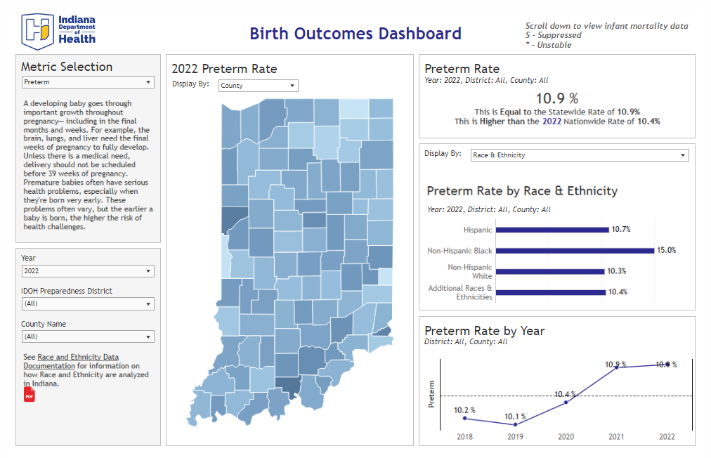
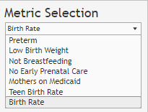
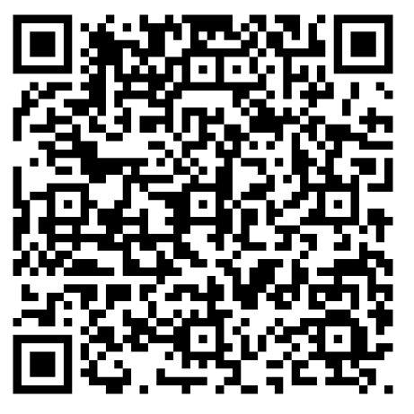
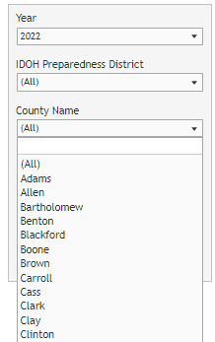
Birth Outcomes

Slide 13
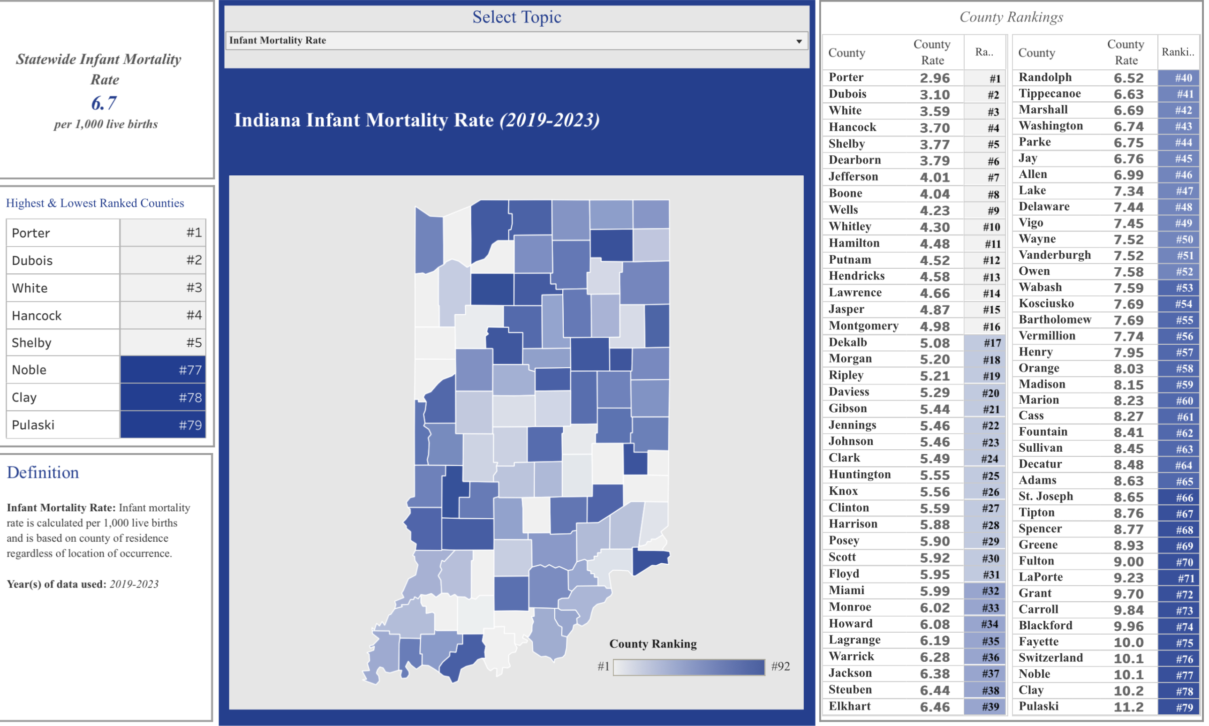
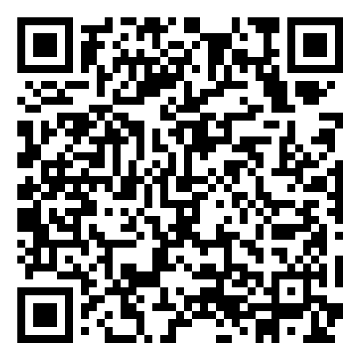

Slide 14

Linked Data

Slide 15
Data description
These are based on Indiana births that were linked to Indiana infant death records.
2018-2022 describes the infant birth year.
The infant death year spans 2018-2023.
Looking at the data this way gives us the ability to analyze the relationships between risk factors and infant mortality rather than the two pieces independently.
The data points in this presentation should not be compared to other materials and statistics based on only birth or death records.

Slide 16
Indiana linked births and infant deaths by race and ethnicity
Non-Hispanic Black infants experience death at a 2 times higher rate than the Non-Hispanic White infant population.
Hispanic infants experience death at a 1.1 times higher rate than the Non-Hispanic White infant population.
Comparisons should not be made to unlinked data sources.
Source: Indiana Department of Health, Family Health Data and Fatality Prevention Division [May 2025]
Indiana Original Source: Indiana Department of Health, Vital Records, ODA

Slide 17
Indiana linked births and infant deaths by age of mom
Comparisons should not be made to unlinked data sources.
Source: Indiana Department of Health, Family Health Data and Fatality Prevention Division [May 2025]
Indiana Original Source: Indiana Department of Health, Vital Records, ODA

Slide 18
Indiana linked data by rural/urban
Comparisons should not be made to unlinked data sources.
Source: Indiana Department of Health, Family Health Data and Fatality Prevention Division [May 2025]
Indiana Original Source: Indiana Department of Health, Vital Records, ODA

Slide 19
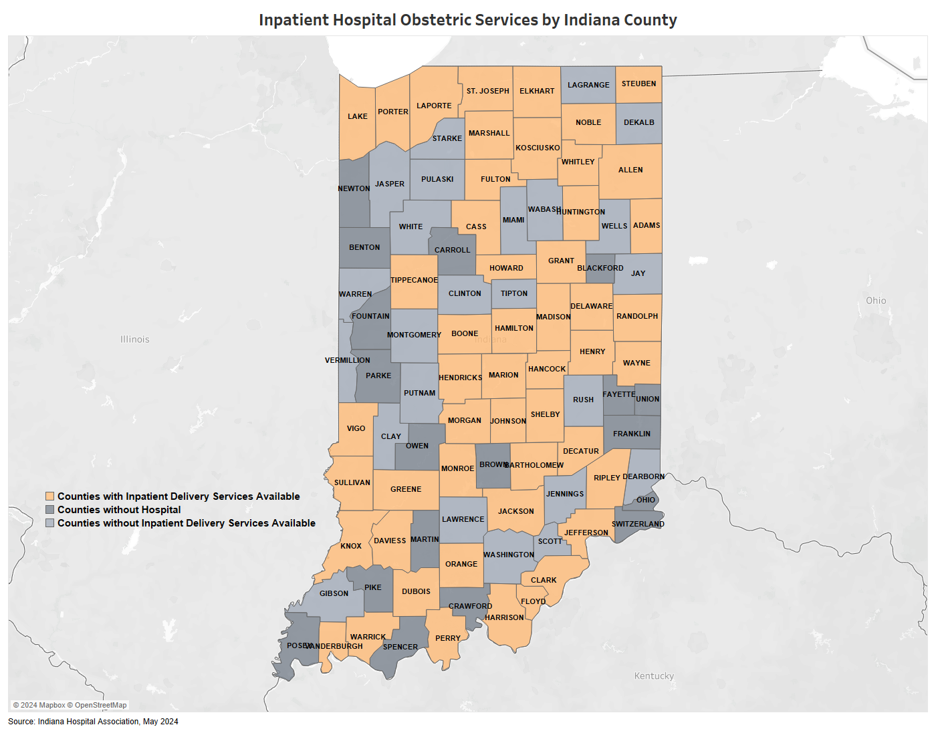
Indiana linked data by hospital access

Slide 20
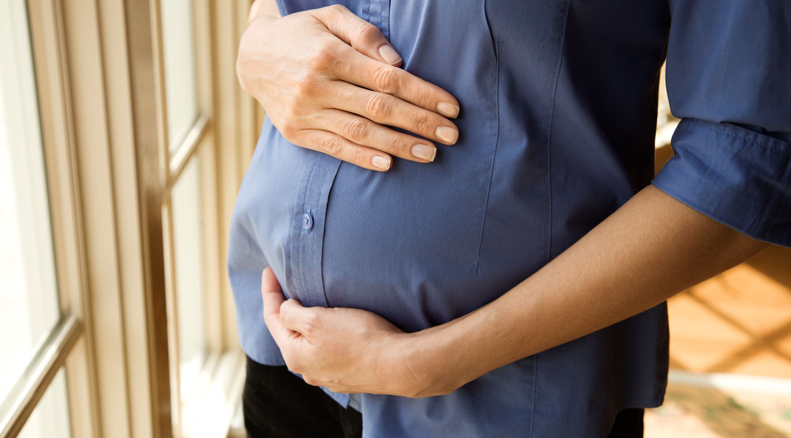
Birth Outcome Indicators

Slide 21
Low Birthweight
61.4%
of infants who died had a low
birthweight (< 2,500 grams).
Over 4%
of low birthweight
births resulted in
an infant death.
Comparisons should not be made to unlinked data sources.
Source: Indiana Department of Health, Family Health Data and Fatality Prevention Division [May 2025]
Indiana Original Source: Indiana Department of Health, Vital Records, ODA
Notes:
4.9% of low birthweight births resulted in an infant death.

Slide 22
62%
of infants who died were born
preterm (< 37 weeks gestation).
Over 3%
of preterm births
resulted in an infant
death.
Preterm
Comparisons should not be made to unlinked data sources.
Source: Indiana Department of Health, Family Health Data and Fatality Prevention Division [May 2025]
Indiana Original Source: Indiana Department of Health, Vital Records, ODA
Notes:
3.9% of preterm births resulted in an infant death.

Slide 23
Smoking During Pregnancy
17.5%
of the infants who
died were born to a
mom who reported
smoking during
pregnancy.
* Percentages based on counts less than 20 are unstable and should be interpreted with caution.
Comparisons should not be made to unlinked data sources.
Source: Indiana Department of Health, Family Health Data and Fatality Prevention Division [May 2025]
Indiana Original Source: Indiana Department of Health, Vital Records, ODA

Slide 24
Early Prenatal Care
2
out
of
every
5
infants who died received no early prenatal
care (1st trimester).
Comparisons should not be made to unlinked data sources.
Source: Indiana Department of Health, Family Health Data and Fatality Prevention Division [May 2025]
Indiana Original Source: Indiana Department of Health, Vital Records, ODA
Notes:
Could not get an appointment when I needed one
Doctor/health plan would not start care as early as I wanted
Didn't know that I was pregnant

Slide 25
Medicaid at the
Time of Birth
52.2% of infants who died were
born to a mother on Medicaid at the time of birth.
Comparisons should not be made to unlinked data sources.
Source: Indiana Department of Health, Family Health Data and Fatality Prevention Division [May 2025]
Indiana Original Source: Indiana Department of Health, Vital Records, ODA
Notes:
Medicaid at the time of birth

Slide 26
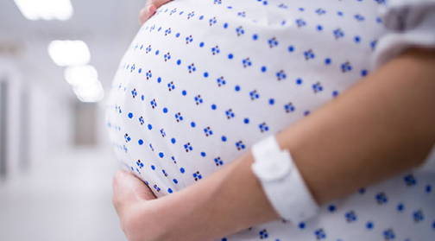
Maternal Health

Slide 27
Hypertension
Before Pregnancy
4.8% of infants who died were
born to a mother who experienced
hypertension before pregnancy.
Comparisons should not be made to unlinked data sources.
Source: Indiana Department of Health, Family Health Data and Fatality Prevention Division [May 2025]
Indiana Original Source: Indiana Department of Health, Vital Records, ODA
Notes:
10.3% of infants who died were born to a mother suffered from hypertension during the pregnancy.

Slide 28
Diabetes Before
Pregnancy
2.6% of infants who
died were born to a mother
who experienced diabetes
before pregnancy.
Comparisons should not be made to unlinked data sources.
Source: Indiana Department of Health, Family Health Data and Fatality Prevention Division [May 2025]
Indiana Original Source: Indiana Department of Health, Vital Records, ODA

Slide 29

Causes of Infant Death in Indiana, 2018-2022

Slide 30
Cause of death by age of mom
*Percentages based on low counts should be interpreted with caution
Comparisons should not be made to unlinked data sources.
Source: Indiana Department of Health, Family Health Data and Fatality Prevention Division [May 2025]
Indiana Original Source: Indiana Department of Health, Vital Records, ODA
Notes:
Cause of Death :EXTREME PREMATURITY, RESPIRATORY FAILURE, PREMATURITY,
UNDETERMINED AND POSITIONAL ASPHYXIA

Slide 31
greater risk of infant death
due to SUIDs when mothers
reported smoking during
pregnancy.
Sudden Unexpected Infant Deaths
(SUIDs)
4.2x
6
Deaths
66.1% of all SUIDs were babies born to mothers
on Medicaid at the time of birth.
Comparisons should not be made to unlinked data sources.
Source: Indiana Department of Health, Family Health Data and Fatality Prevention Division [May 2025]
Indiana Original Source: Indiana Department of Health, Vital Records, ODA

Slide 32
19.6% of SUIDs were linked to a baby who was born preterm or low birthweight.
Preterm or Low Birthweight Births and SUIDs
1
out
of
every
5
Comparisons should not be made to unlinked data sources.
Source: Indiana Department of Health, Family Health Data and Fatality Prevention Division [May 2025]
Indiana Original Source: Indiana Department of Health, Vital Records, ODA

Slide 33
2023 summary
524 infants in Indiana died before their first birthday
Perinatal risks are the primary cause of infant mortality in Indiana
More than 18% of infant deaths can be attributed to SUIDs and unsafe sleep
Most Indiana infant deaths were either premature or low birthweight babies
Smoking and no early prenatal care during pregnancy are linked to higher percentages of infant death
Trends exist between cause of infant death and the age of mom
Source: Indiana Department of Health, Family Health Data and Fatality Prevention Division [March 7, 2025]
Original Source: Indiana Department of Health, Vital Records, ODA

Slide 34
What women are saying
“I think there should be more options for smaller towns. I drive 30 minutes to get to my doctor. Transportation assistance would help. A lot of times women don't get prenatal care because they can't get there.”
“I am concerned about the lack of prenatal care for those who live in rural communities. For example, in my community/county, there is no hospital where mothers can give birth. An OB provider only comes two times a month to our county.”
“Many people in rural areas have a lack of transportation and getting to appointments 30 minutes+ away can be extremely difficult. I am fortunate that I have a car and enough gas money to travel to appointments.”
“I developed preeclampsia during post-partum, and I believe there should be more awareness for this.”
Data source: Indiana PRAMS

Slide 35

Children’s Health

Slide 36






Children’s Health
94% of Indiana parents of children ages 0-5 and 91% of parents of children ages 6-11 reported their child in excellent or very good health. (NSCH, 2021-2022).
33% of Indiana children ages 6-11 are physically active for 60 minutes every day compared to just over one-fourth of all United States children ages 6-11 (NSCH, 2021-2022).
36% of Indiana children ages 6-11 are overweight or obese (NSCH, 2021-2022).
31.4% of students reported eating vegetables one or more times per day in the 7 days before the survey (YRBS, 2023)
90.9% of students reported eating fruit one or more times per day in the 7 days before the survey (YRBS, 2023)
24.5% of students reported eating at least one meal or snack from a fast-food restaurant on three or more days in the 7 days leading up to the survey (YRBS, 2023)
Notes:
Recreate graphics? Make snips similar in size?

Slide 37
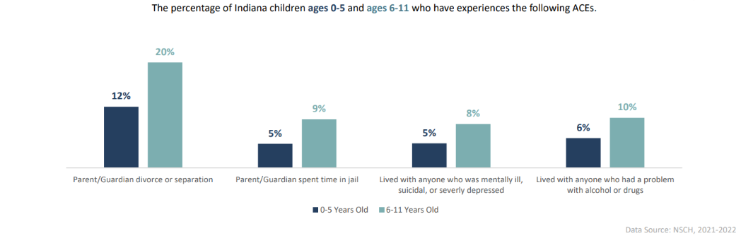
ACEs
More than one out of four Indiana children ages 0-5 have experienced at least one adverse childhood experience (ACE) and more than one in three Indiana children ages 6-11 have experienced at least one ACE.
44% of Indiana children ages 6-11 were bullied, picked on, or excluded by other children at least once in the past 12 months (NSCH, 2021-2022).

Slide 38
Injury-related fatalities
Injury is the leading cause of death among children​ in Indiana
From 2007 – 2022 in Indiana, 4,422 children died from injuries (ages 0 – 17 years)​
In 2022, there were 1,519 hospitalizations and 131,109 emergency department visits ​among children
Every four minutes, a child is treated for an injury in an emergency room in Indiana
Injury deaths are preventable!
Sources: IDOH Division of Trauma and Injury Prevention Special Emphasis Reports
Indiana Department of Health Vital Records, ODA

Slide 39
Top five injury-related child deaths by cause/manner, Indiana 2023
<12 months | 1-4 years | 5-9 years | 10-14 years | 15-17 years
SUID (96) | Drowning (11) | Transportation accident (9) | Suicide (18) | Homicide (35)
Suffocation (8) | Transportation Accident (10) | Homicide (4) | Homicide (9) | Transportation Accident (31)
Homicide (7) | Homicide (8) | Drowning (2) | Transportation Accident (6) | Suicide (23)
Unintentional and Undetermined Poisoning (1) | Fire (6) | Unintentional Firearm (2) | Unintentional and Undetermined Poisoning (3) | Unintentional and Undetermined Poisoning (22)
Transportation Accident (1) | Unintentional and Undetermined Poisoning (5) | Fire (2) | Drowning (2) | Unintentional and Undetermined Firearm (5)
*This table only includes the top five causes/manners of death and does not reflect the total number of child deaths that occurred in 2023.
Source: Indiana Department of Health, Vital Records, ODA

Slide 40

Adolescent Health

Slide 41
Adolescent Well-Visit
72% of Indiana adolescents have a personal doctor or nurse (NSCH, 2021-2022), and 71% of Indiana young adults have one or more personal doctors (BRFSS, 2022).
77% of Indiana adolescents and 70% of Indiana young adults received a preventive care visit in the past 12 months (NSCH, 2021-2022 & BRFSS, 2022).
12% of Indiana young adults had a time in the past 12 months where they needed to see a doctor but could not afford it (BRFSS, 2022).
39% of Indiana adolescents did not receive needed care coordination (NSCH, 2021-2022).
Mental Health (YRBS, 2023)
students reported poor mental health most or
all of the time in the past 30 days
2
out
of
every
5

Slide 42
Trends in Current E-Cigarette Use, Middle & High School, IYTS 2012-2024
Notes:
In 2024 we see a decrease in e-cigarette Use among high school students (STATISTICALLY SIGNIFICANT) and a slight increase in e-cigarette use among middle school students.
This measure is another of TPC’s Strategic Plan Long-Term Objectives, specifically for High School students. The objective is to reduce vaping/e-cigarette use among HS students to 10% in 2025.

Slide 43
What teens are saying:
“For me, I would say just being active. I'm in high school right now and I think it's very easy to get opportunities to go to the gym with friends or go to a club or sports team. And I think it's just really easy to connect with people who also want to be active. I definitely would say one of the biggest things is physical health and just being active at least like 30 minutes a day.”
I think a lot of the concerns of people my age, mental health is definitely, ‘What's next?’ Concerns about having already a crisis about life.”
“I'm in high school right now, but going through middle school, I thought that a lot more people were hit by depression in middle school versus high school. So, I think a bit more resources directed towards middle schoolers to help with their depression.”
“I think with the eating healthy; I was never really taught what a nutritious meal is or even benefits of drinking water for example.”
“Mental health groups, these nonprofit organizations are generally considered taboo or something only crazy people go to, I guess. That's the general idea for our school.”

Slide 44

Women/Maternal Health

Slide 45





Women/Maternal
84% of Indiana women visited the doctor within the last 12 months (BRFSS, 2022).
10% of Indiana females reported that there was a time in the past 12 months when they needed to see a doctor but could not afford it.
26% of Indiana women reported running out of food and not having enough money to get more at least once in the past 12 months (BRFSS, 2022).
40% of Indiana women said that their mental health (including stress, depression, emotional problems) was not good for 3 or more days in the last 30 days (BRFSS, 2022).
13.% of women in Indiana were diagnosed with diabetes (BRFSS, 2023).
1.7% of women in Indiana ages 18-44 who reported being told by a health professional that they had angina or coronary heart disease, a heart attack or myocardial infarction, or a stroke (BRFSS, 2021).
11.5% women ages 18-44 who reported being told by a health professional that they have high blood pressure (BRFSS, 2021)

Slide 46
Women/Maternal
“A lot of us don't have health insurance or the money for a therapist, but maybe we just want to talk to one because we can't talk to family, they're judgmental. You can't talk to friends because you don't know anybody really. So, it's like we just want that one person that we can actually confide into without them spilling our business to everybody else.”
“It would be nice if there were questions that normalized mental health counseling as routine instead of only addressing depression and anxiety. There is a difference between mental health and mental illness.”
“Regarding depression after pregnancy, I didn't find it very beneficial to ask in front of my husband if I was depressed or sad. I didn't answer honestly because I didn't want to disappoint my husband.”
“I feel like we need more resources for post-partum depression.”

Slide 47

Maternal Mortality

Slide 48
Indiana pregnancy-associated five-year MMRs: 2018-2022
91.6 deaths per 100,000 live births
rate of pregnancy-associated deaths
in Indiana in 2018-2022
The death of a woman from any cause
during pregnancy or within one year of
the end of pregnancy
17.2 deaths per 100,000 live births
rate of pregnancy-related deaths in
Indiana in 2018-2022
The death of a woman during pregnancy or within one year of the end of pregnancy from a pregnancy complication, a chain of events initiated by pregnancy, or the aggravation of an unrelated condition by the physiological effects of pregnancy
MMR=Maternal Mortality Rate

Slide 49
Indiana pregnancy-associated MMRs: 2018-2022 (N=367)
N=92
N=80
N=72
N=63
N=60
N=15
N=18
N=14
N=10
N=12
MMR=Maternal Mortality Rate
*Rates based on counts less than 20 are considered unstable and should be interpreted with caution.

Slide 50
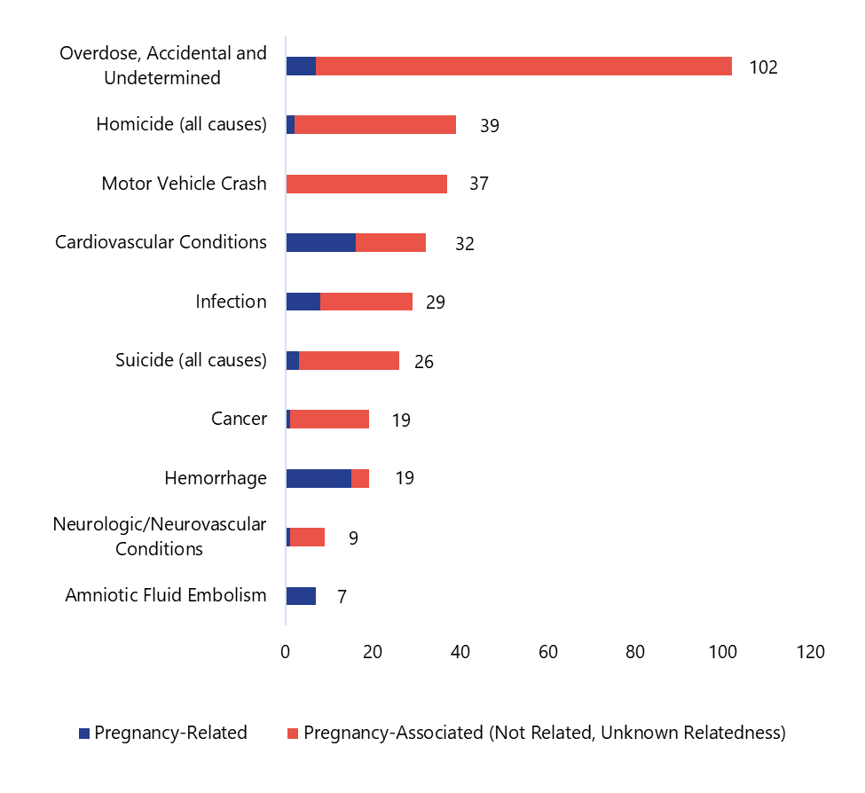
Top causes/manners of Indiana pregnancy-associated maternal mortality: 2018-2022

Slide 51
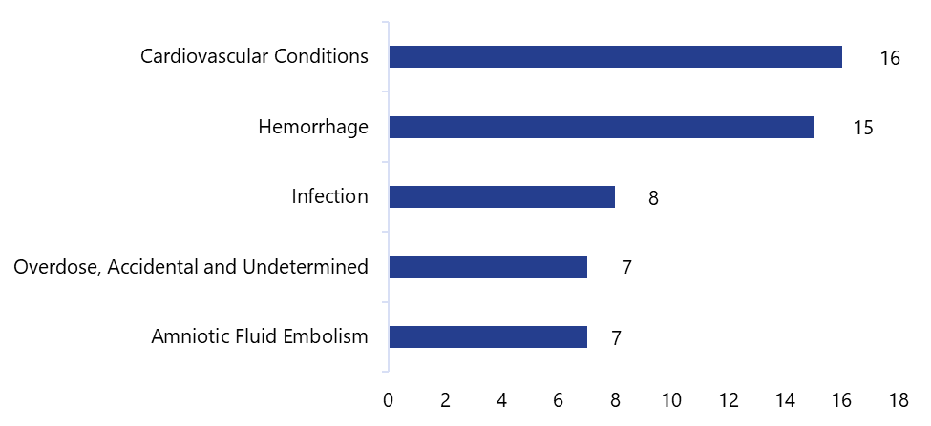
Top causes of Indiana pregnancy-related maternal mortality: 2018-2022
Notes:
*Cardiovascular conditions include cardiomyopathy
*Hemorrhage includes ruptured ectopic

Slide 52

Priorities

Slide 53
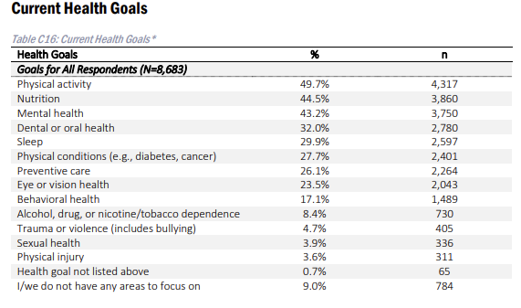
State Priorities
Priorities
Survey
Focus Groups
Secondary Data
MCH Landscape
IDOH Role and Capacity
Notes:
Current Funded programs: across the state through IDOH, other state agencies, & local partners

Slide 54
Priorities for improving MCH outcomes
Reduce preventable deaths and advance quality of life
Address social drivers of health and systems that influence health status and behaviors
Improve physical health and strengthen mental, social, and emotional well-being
Promote protective factors and uplift Hoosier families

Slide 55

Current statewide work

Slide 56
Perinatal Levels of Care
In September 2019, 410 IAC 39, or Perinatal Hospital Services, went into effect
Requires all hospitals that offer obstetric and neonatal care to be certified as Level I, Level II, Level III or Level IV, based on the services they offer
Perinatal Centers: nine delivery hospitals who provide support and mentorship to other OB Departments across the state

Slide 57
Perinatal Levels of Care
Improves care coordination by facilitating maternal and neonatal transport services to higher-level care facilities
More than 80% of our birthing facilities increased their communication and partnerships amongst birthing facilities to share hospital policies, protocols, and practice changes
Birthing hospitals are now actively engaging in QI projects to enhance the overall standard of care.
Birthing facilities regularly conduct multidisciplinary simulation trainings

Slide 58
Indiana AIM
Indiana’s AIM Team is housed in the Indiana Department of Health’s Maternal and Child Health Division
Joined the National AIM team in January 2019
First bundles chosen to align with recommendations from the 2019 and 2020 Maternal Mortality Review Committee (MMRC) Annual Reports for pregnancy related deaths.
Obstetrical Hemorrhage (OB HEM)
Launched in April 2019
100% enrollment (74/74)
Severe Hypertension (HTN) in Pregnancy
Launched in March 2021
100% enrollment (74/74)
Care for Pregnant & Postpartum Women with Substance Use Disorder
Pilot program, launched in 2022
23 facilities participating
Postpartum Discharge Transition
Pilot program, launched in 2024
8 facilities participating

Slide 59
Fatality Review Teams
Maternal Mortality Review Committee (MMRC) reviews the death of all Indiana residents who died while pregnant or within one year of pregnancy, irrespective of cause.
Statewide team
Fetal Infant Morality Review (FIMR): Local teams are required to review deaths that occur during pregnancy and deaths that occur within 12 months following delivery
In Indiana, there are 22 FIMR teams covering 69 counties
Also includes bereavement services for women and families who experience pregnancy loss
Community Action Teams (CATs) act as the prevention arm of the FIMR process

Slide 60
Fatality Review Teams
Child Fatality Review teams review sudden and unexpected deaths of infants and children under 18.
CFR teams are local, with coverage in all 92 counties
Includes a state team
Suicide & Overdose Fatality Review (SOFR) teams review deaths by suicide and overdose ages 18 and above
30 teams covering 31 counties and counting
Provide critical information for prevention activities at the local level
Local reviews mean local solutions

Slide 61
Lactation after Loss Program
The Issue
Lactation can occur after a miscarriage, stillbirth, or infant death
Women may not be aware their milk will come in or what their options are for lactation after a loss
“I wish I’d known that my milk would come in and that I had a choice about what to do with it.”
“The only thing anyone mentioned to me, was to bind my breasts.”
How we are addressing the issue
Ensure women and families know lactation may occur and are aware of their options
Partnering with The Milk Bank to provide anticipatory guidance in the clinical setting
Suppression
Expression
Donation
Provide lactation care, bereavement support, and IDOH Pump Kits to women in need of a breast pump or additional help after a loss
Bereavement care used as innovative prevention

Slide 62
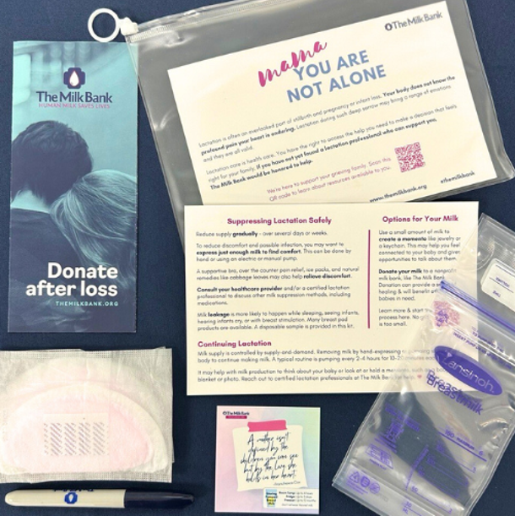

Lactation after Loss Program Anticipatory Guidance
Scan to Request The Milk Bank Anticipatory Guidance Kits

Slide 63
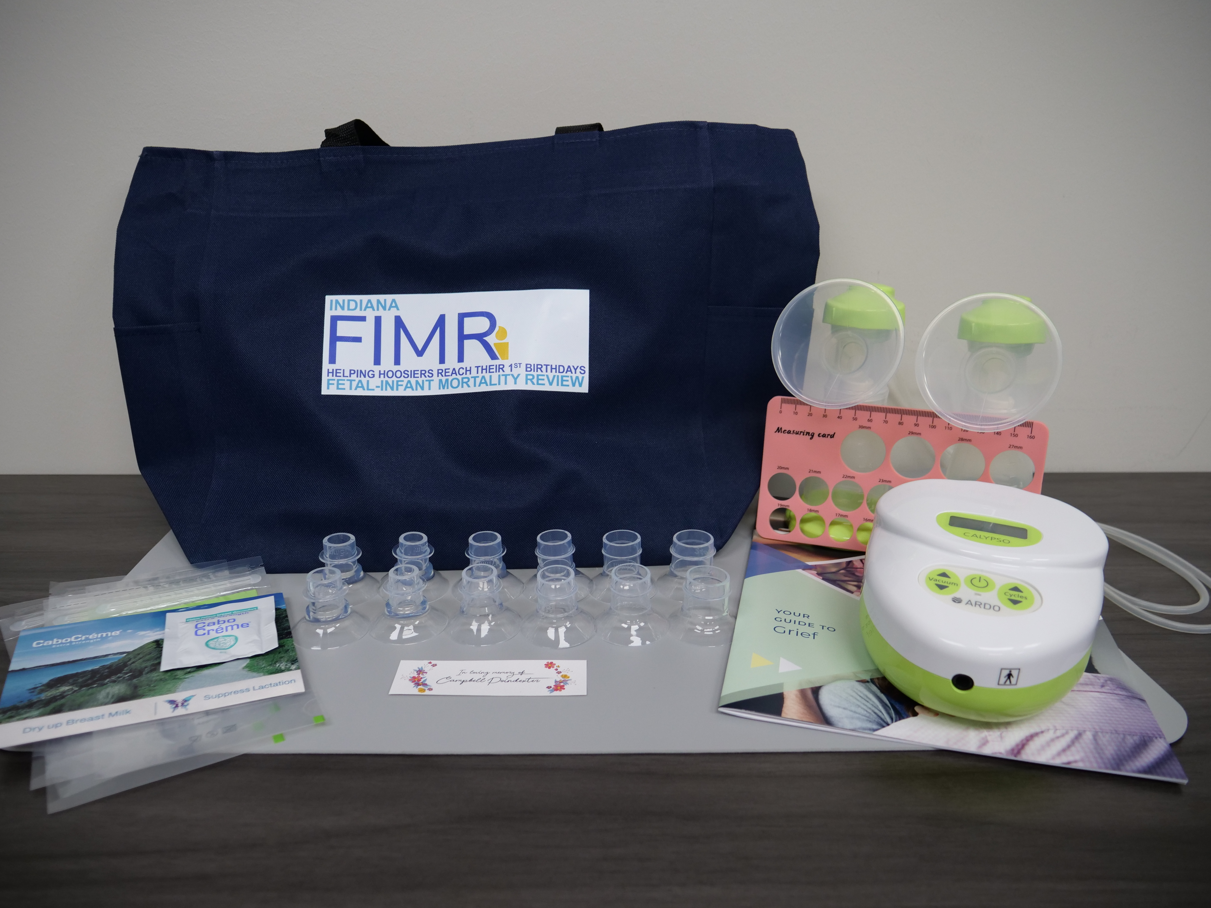
Lactation after Loss Program
Families and providers can reach out to IDOH for more support
Pump Kits
Bereavement Support
Lactation Care
Email IDOHFIMR@health.in.gov with questions or for more information

Slide 64
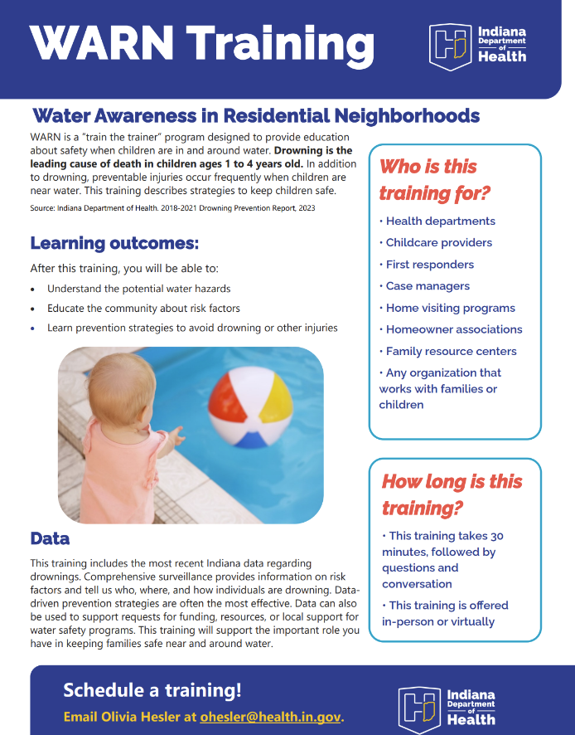
WARN Training
The Division of Family Health Data and Fatality Prevention offers a free training for local partners to learn more about how to promote water safety in their communities.
Water Awareness in Residential Neighborhoods
This training is typically 30 minutes with time for conversation and questions at the end.
Certificates are sent to all participants for proof of completion following all trainings.
Interested in being trained in WARN?
Email Olivia Hesler at ohesler@health.in.gov!

Slide 65
Make Indiana Healthy Again Executive Orders
25-56: Increasing Consumer Transparency Related to Food Dyes and Additives
IDOH will conduct a comprehensive assessment on the health impacts of artificial food dyes and additives
IDOH Food Protection Division leading efforts and will coordinate workgroup
25-57: Development of A Comprehensive Diet-Related Chronic Disease Plan
IDOH will lead – work already underway as a result of foundational work done by the Obesity Innovation Team
The IDOH Obesity Innovation team will transition to a workgroup to support development of this plan
25-58: Increasing Hoosier Access to Local Foods
ISDA will lead, with IDOH supporting, development of a comprehensive study related to Hoosiers' access to local foods
The DNPA will coordinate internal workgroup to support this effort
25-59: Promoting the Health and Wellness of Hoosier Students
IDOE will lead, with IDOH supporting, set of recommendations to encourage healthier, local food options in schools, and several other school health-related directives
The DNPA and IDOH School Health Innovation Team will lead internal workgroup
Notes:
Naima Gardner

Slide 66

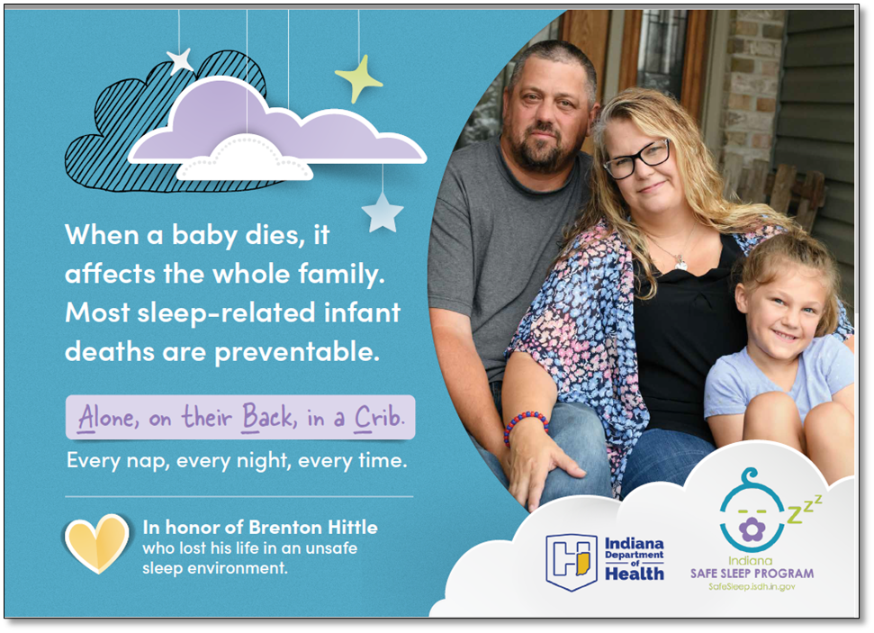
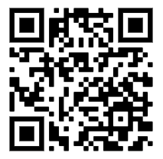
Safe sleep resources
In 2021 the Division of Family Health Data and Fatality Prevention (DFP) developed and released their first infant safe sleep awareness push for community partners.
Materials featured three families that experienced a loss from unsafe sleep and shared their stories with the hopes of preventing this from happening to other families.
Video testimonials are available along with printed resources that DFP directly ships to local organizations to give out to families at no cost.
Print resources are available in English, Spanish, Burmese, and Haitian Creole.
To learn more scan the QR code or visit: https://www.in.gov/health/safesleep/safe-sleep/resources/

Slide 67

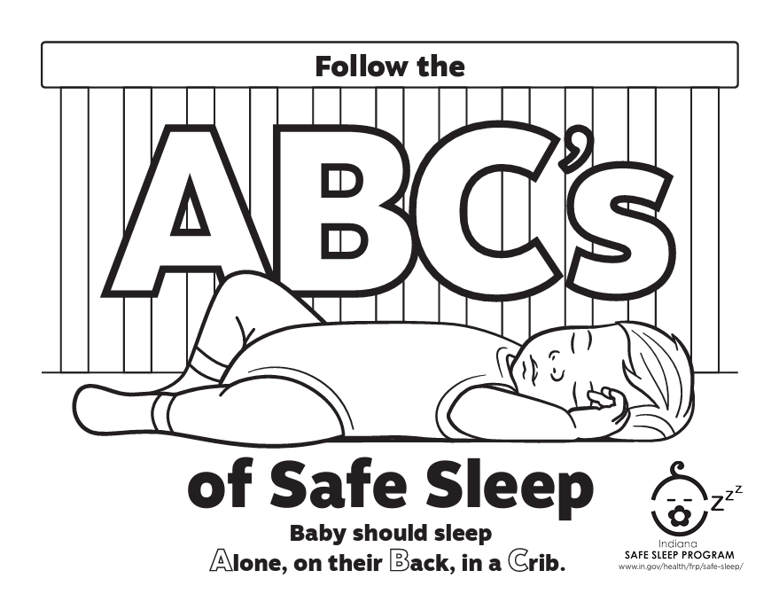
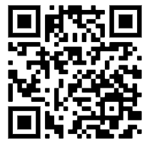
Safe sleep activity sheets
A recommendation for safe sleep education targeting young children/siblings of infants was created through a local Child Fatality Review (CFR) team.
Following this recommendation the DFP prevention team developed two coloring/activity sheets that contain safe sleep education that is primarily for younger children.
These activity sheets have been used in pediatrician waiting rooms, distributed during home visiting check-ins, and many other touch points with little ones.
To access these activity sheets, scan the QR code or visit: https://www.in.gov/health/safesleep/safe-sleep/resources/

Slide 68

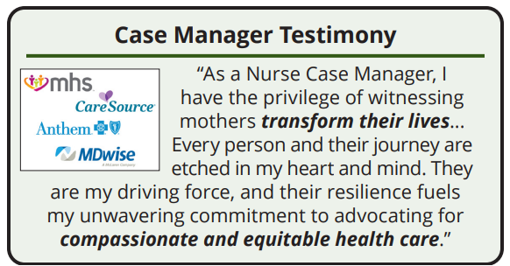
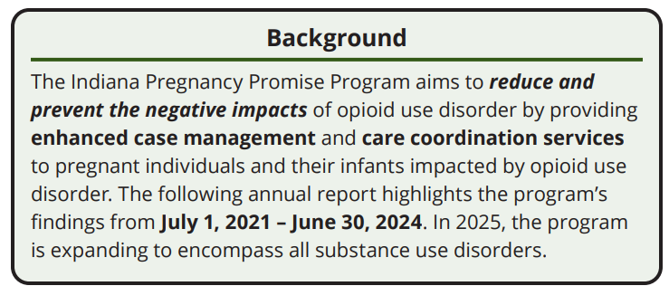
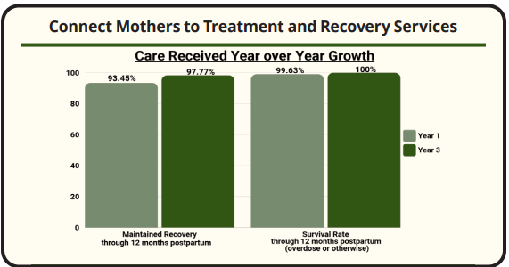

Slide 69
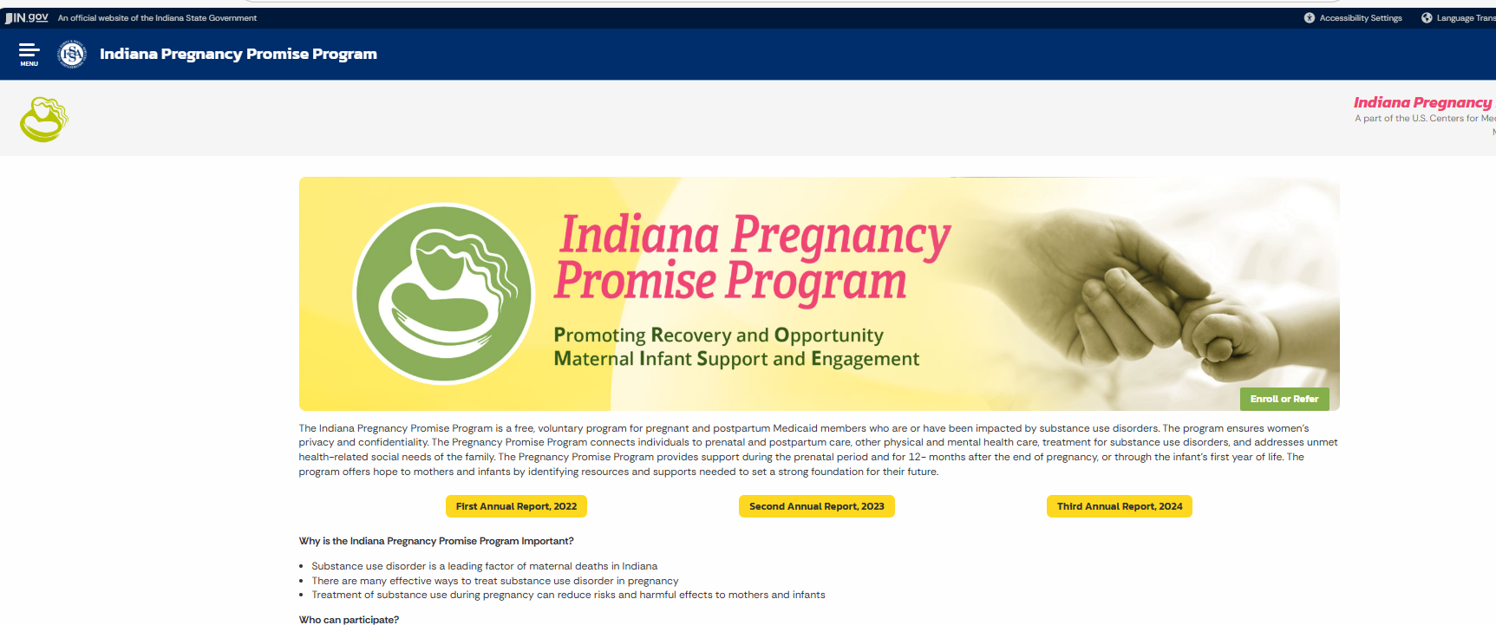
Indiana Pregnancy Promise Program
Substance use disorder is a leading factor of maternal deaths in Indiana
There are many effective ways to treat substance use disorder in pregnancy
Treatment of substance use during pregnancy can reduce risks and harmful effects to mothers and infants
The Pregnancy Promise Program is available to pregnant women in the state of Indiana. To be eligible participants must meet the following criteria:
Be pregnant or within 90 days of the end of pregnancy
Identify as having current or previous substance use
Be eligible for Medicaid health coverage
Pregnancy Promise Program Enrollment Form: FSSA Public

Slide 70

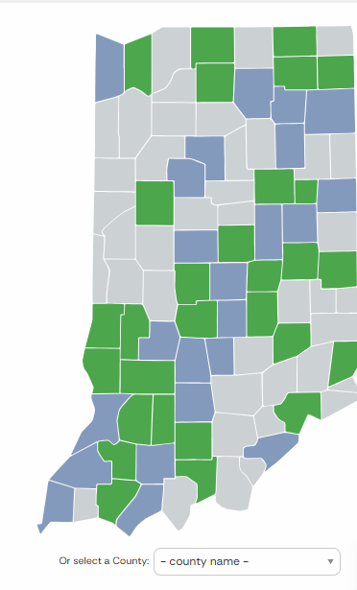
Handle with Care
The Handle with Care (HWC) program is a notification system that enables law enforcement and other first responders to notify schools when a child has been at the scene of a potentially traumatic event, allowing schools and mental health partners to provide trauma-sensitive support.
By ensuring children have safe, stable, and nurturing environments for healthy development and learning, the potential effects of trauma can be mitigated.
If law enforcement or first responders encounter a child during a call, that child’s name and three words, Handle with Care, are forwarded to the school/childcare agency before school the next day.
The school implements individual, class and whole school trauma-sensitive curricula so that traumatized children are “Handled with Care". If a child needs more intervention, on-site trauma-focused mental healthcare is available at the school.

Slide 71
Indiana WIC
The Indiana WIC program focuses on the assessment of nutrition risk for income-limited mothers, infants, and children. This assessment guides the program's provision of nutrition education, healthy supplemental food, and breastfeeding support.
Indiana WIC has clinics in all 92 Hoosier counties, improving food security, health outcomes, and breastfeeding support for mothers and their children up to age 5.
Indiana WIC served an average of 148,000 individuals per month across the state of Indiana
Indiana WIC's investment in local communities results not just in healthier families, but also stable, local jobs; investment in infrastructure; and a natural partner with the state's Health First Indiana initiative
“My kids are outgrown at this age now, but WIC was a tremendous resource for our family when my kids were eligible for it. I used it with every single one of my kids. So, obviously the food resources but also just the educational resources that they offered. They would do clinics sometimes. I think with my last kiddo, they even offered money for the kids to use at the farmer's market.”

Slide 72

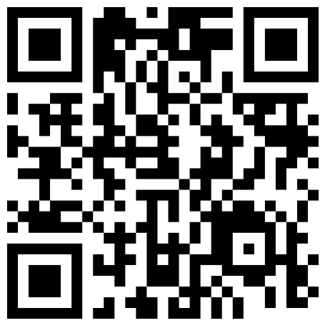
Health First Indiana
Notes:
Note how we think of HFI and what it has meant for the county health departments, but it also includes transformative changes for child health. IDOH is working to put health first for all Hoosiers.

Slide 73
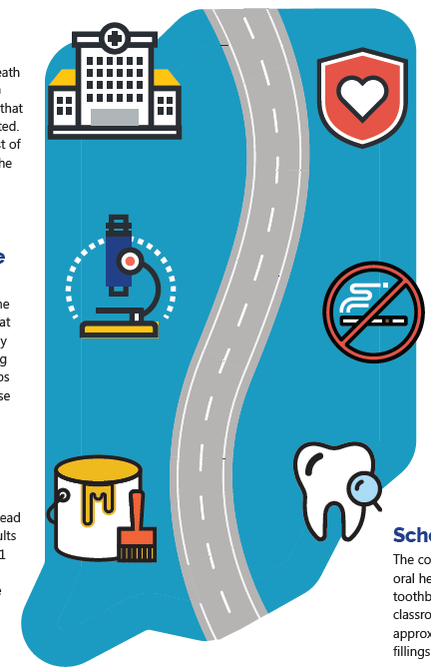
Health First Indiana Basics
Investment in public health is investment in a healthier future.
FY 2024 $75M and FY 2025 $150M for LHDs
Previously $6.9M/year for 20+ years
At least 60% of funding has to be spent preventive health services. No more than 40% on regulatory
Requires less than 10% spent on capital (land, buildings, and vehicles)
Counties opt in to the funding
Requires state and county KPIs
Indiana is transforming the state’s public health system with the funding that will strengthen the delivery of core services to ensure that the state is prepared for the future.
Notes:
Now that I’ve set the stage and explained the WHY – let’s get to the exciting part, which is where we are going and how it will benefit not just individuals, but families, communities, businesses and the state as a whole.

Slide 74
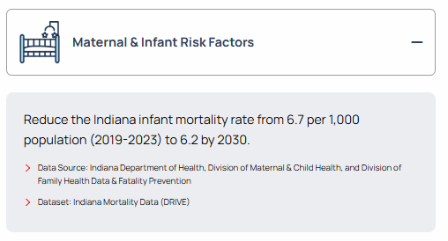

State KPI: Maternal and Child Health

Slide 75

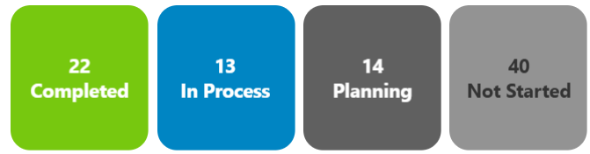
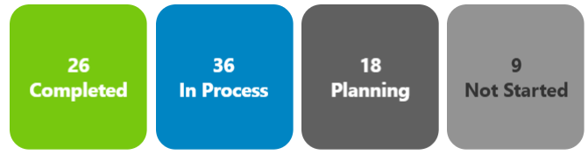
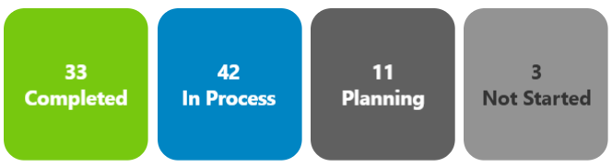
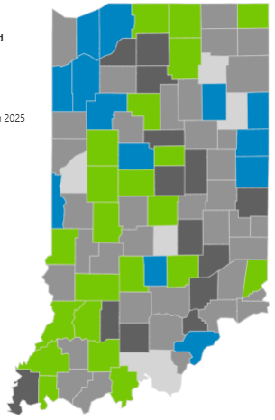
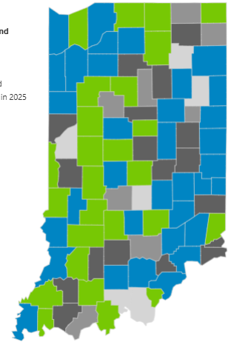
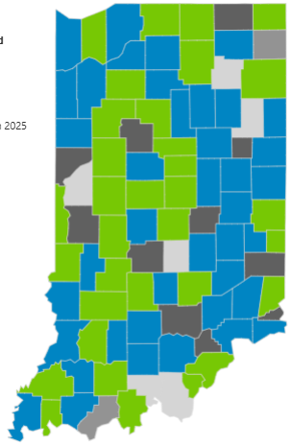

Has your LHD implemented a comprehensive, evidence-based or promising program or activity to improve birth outcomes in your community?
35
75
June
2024
December 2024
December 2023

Slide 76
LHDs: Maternal and Child Health
Kosciusko Early Start Prenatal Clinic: The early start prenatal clinic provides mothers with their initial OB visit and then coordinates ongoing care through the local hospital OB services. Using HFI funding, the clinic also offers vouchers to ensure women have access to follow-up prenatal care.
Elkhart County has a Healthy Beginnings Program that provides resource care and coordination to expectant mothers. Referrals come through WIC and local OB offices. There is a constant flow of referrals coming into the program, and strong community partnerships assist with referrals going out into the community.
Jefferson County is partnering with their local delivering hospital, Kings Daughter's Medical, to provide a Maternal and Child Health navigator.

Slide 77

Water Safety

Slide 78


Drowning prevention mini-grants
Photos from a water safety event hosted by our Indiana University grantee in April.

Slide 79
Facts about drowning
In 2018 through 2023, 127 children in Indiana ages 0-17 years died by drowning.
Every year, drowning is the leading cause of death for Indiana children ages 1 through 4 years.
Nearly half of drowning deaths are among infants and toddlers
Infants (0 to 12 months) are most likely to drown in bathtubs
Most drowning deaths among children ages 1 through 4 years occur in residential swimming pools
The likelihood of drowning in open water sites (such as lakes, rivers and oceans) increases with age
Two-thirds of drowning deaths occur between May and August
Source: Centers for Disease Control and Prevention, 2024

Slide 80
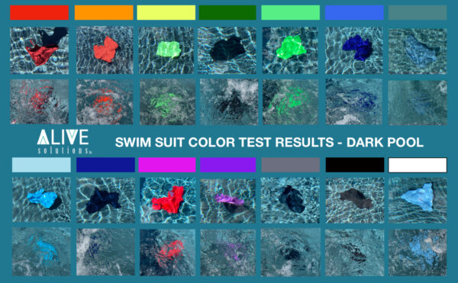
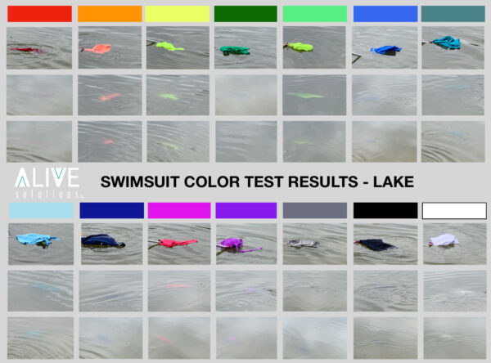
What can you do?: Water Safety Messaging
Example of water safety messaging: Swimsuit color test in a dark pool
Example of water safety messaging: Swimsuit color test in a lake
Source: Alive Solutions, 2023
Notes:
In the image on the left, the two top rows of pictures show the suit on the surface of the water. The second row of pictures are the suits submerged 18 inches below the surface with water agitation
•Swimsuit colors, like blues and greens, are difficult to see when under water.
•White swimsuits can look like clouds reflecting on the water.
•Dark colored swimsuits can disappear in lakes or pools with dark bottoms.
•Neon colored swimsuits, like bright orange and yellow, make it easier to spot a child in different bodies of water.
The image on the right shows swimsuit colors in a lake. The first row of pictures show the suit on the surface of the water. The second row shows a shore-level perspective. The third row of pictures are from a slightly elevated perspective.
Just this simple messaging can help parents make decisions about what color swim wear to purchase for their children. This seemingly small decision can make the difference between finding a child in the water quickly or not.

Slide 81


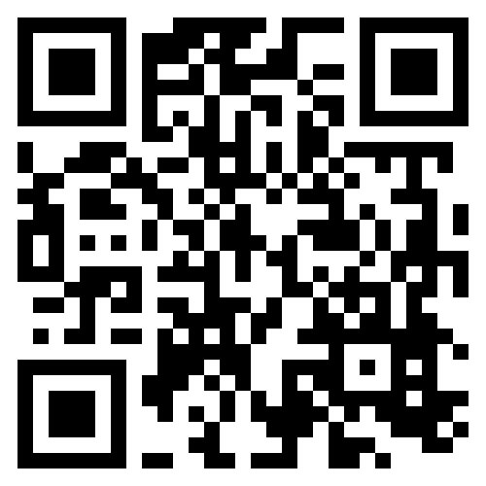
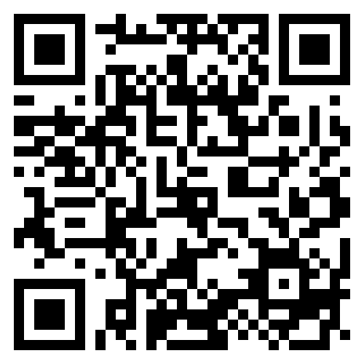
What you can do?
Water Safety Season Toolkit for parents, communities, rental homes, teachers, lifeguards:
Phones Down Eyes Up Pledge: Designate a Water Watcher—an adult who stays focused and free from distractions
The Division of Family Health Data and Fatality Prevention offers a free training for local partners to learn more about how to promote water safety in their communities.
Interested in Water Awareness in Residential Neighborhoods (WARN)?
Email Olivia Hesler at ohesler@health.in.gov
Notes:
First is the toolkit from the that includes the compelling “the clothes they wore” campaign we saw on the previous slide. It also includes a full campaign schedule compiled of National Drowning Prevention Alliance’s top social posts, Video PSA’s, sharable blogs, press release templates, printable documents and so many more resources to help you advocate for water safety and drowning prevention from May through August.
Second is the Water safety campaign Phone Down, Eyes Up, rom the YMCA. Responding to a text, answering an email, listening to a podcast, or making a grocery list—these tasks may seem quick and harmless, but those few seconds of distraction can add up. And distractions around water can lead to serious, even fatal, consequences. That’s why families must designate a Water Watcher—an adult who stays focused and free from distractions like phones, conversations, or alcohol who can maintain constant visual contact with all children in or near the water.
And third, the IDOH Division of Family Health Data and Fatality Prevention offers a free training for local partners to learn more about how to promote water safety in their communities.
Water Awareness in Residential Neighborhoods
This training is typically 30 minutes with time for conversation and questions at the end.
Certificates are sent to all participants for proof of completion following all trainings.
Interested in being trained in WARN?
Email Olivia Hesler at ohesler@health.in.gov

Slide 82
Investing in what works
Healthy women and families are more likely to have healthy babies
Meet women and families where they are
Ensure facilities are ready for the unexpected (and expected!)
Invest in primary, secondary, and tertiary prevention
Public health is local

Slide 83
Questions? Eden Bezy, MPH
Assistant Commissioner
Women, Children, and Families
Ebezy@health.in.gov

