Slide 1

Community-driven opportunities for Healthcare
and Oral Health Collaborations
Dr. Tamara Gierke Button DDS MSD FICD FACD
Executive Director, Dunebrook
President, Southshore Skipping Stones

Slide 2
Disclosure
I do NOT have any relevant financial relationships with any commercial interests.
My presentation will contain NO reference to an investigational and/or off-label use of a product.

Slide 3
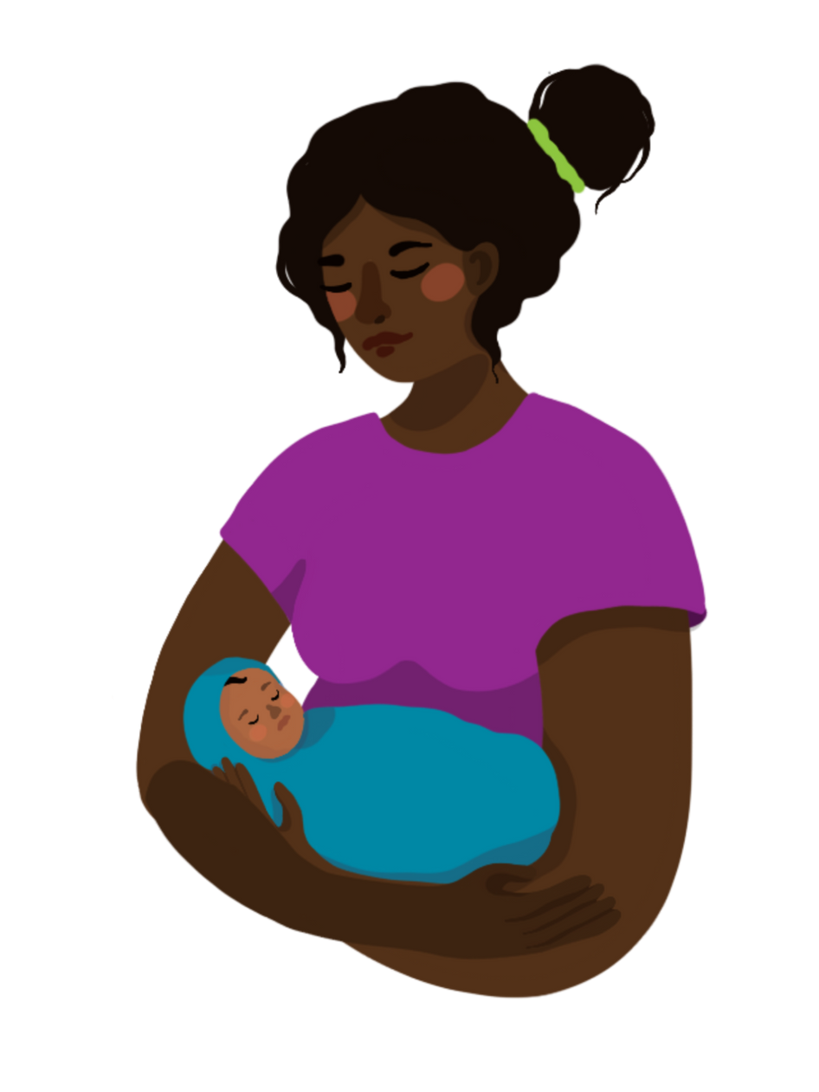

Establishing the foundation for wholesome oral health begins during pregnancy and continues the day your baby is born!

Slide 4

Welcome to your healthy home!!

Slide 5

Objectives:
Illustrate the critical importance of oral health during the first 1,000 days of life and its impact on long-term oral health outcomes
Explore effective community-based strategies to promote oral health among pregnant individuals and infants, emphasizing culturally responsive approaches
Discuss the role of interdisciplinary collaboration in integrating oral health education and services into community health programs to enhance access and equity

Slide 6

First 1000 days of Life
Defined as Pregnancy through 2nd birthday
“Golden Period” for interventions and actions to prevent:
Obesity
Diabetes
Cardiovascular Disease
Early childhood caries/dental caries
Abanto, Jenny et. Al.: Impact of the first thousand days of life on dental caries through the life course: a transdisciplinary approach. Braz. Oral Res. 2022; 36:e113.

Slide 7
First 1000 days of Life
The most critical time to effectively prevent early childhood caries is during pregnancy and the first six months of life
Pregnancy: 280 days
First six months: 180 days
Total: 460 days
Age 1 Dental Visit: 640 days – 820 days
Abanto, Jenny et. Al.: Impact of the first thousand days of life on dental caries through the life course: a transdisciplinary approach. Braz. Oral Res. 2022; 36:e113.

Slide 8


WHAT IS PREVENTION?
Primary Prevention: Intervening before health effects occur
Secondary Prevention: Screening to identify disease in the earliest stages, before the onset of signs and symptoms
Tertiary Prevention: Managing disease post diagnosis to slow or stop disease progression
https://www.cdc.gov/pictureofamerica/pdfs/picture_of_america_prevention.pdf

Slide 9
AGE ONE DENTAL VISIT
Secondary Prevention: Screening to identify disease in the earliest stages, before the onset of signs and symptoms
Tertiary Prevention: Managing disease post diagnosis to slow or stop disease progression
https://www.cdc.gov/pictureofamerica/pdfs/picture_of_america_prevention.pdf

Slide 10
Oral health IS overall health and there is no way to separate one from the other…

Slide 11

What is Dental Caries?
A bacterial disease that can lead to tooth decay and cavities

Slide 12

How does dental caries cause cavities?
Cavity causing bacteria grow
Cavities are an advanced symptom!
Sugars and acids in foods help them to grow
Plaque is not removed effectively every day
When your mouth is acidic, enamel breaks down
What is causing the growth of the bacteria?????

Slide 13
How do we “get” the bacteria that cause dental caries??

Slide 14
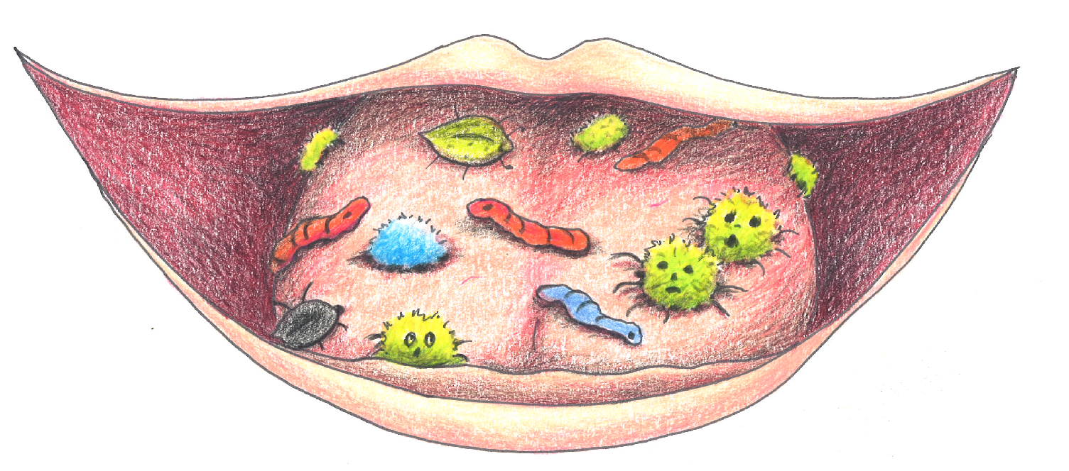
Pregnancy Oral Health

Slide 15
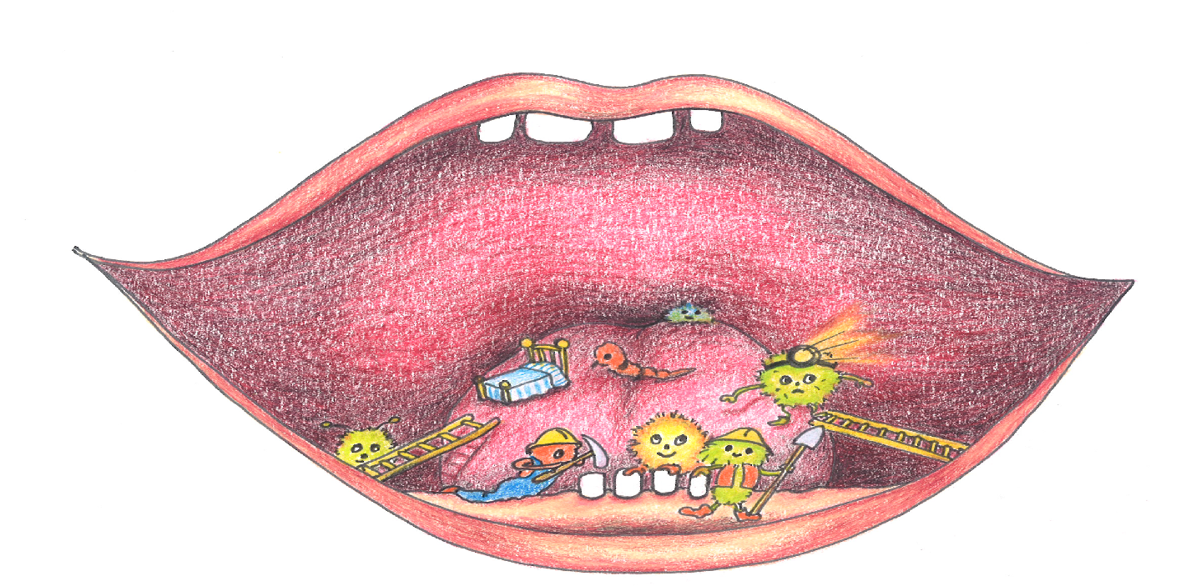
Pregnancy Oral Health

Slide 16
Welcome to your healthy home!!

Slide 17


Pregnancy Oral Health

Slide 18

DOES MATERNAL ORAL HEALTH EFFECT PREGNACY HEALTH?
Dental
Caries
Periodontal Disease
ECC
BACTERIAL INFECTION
INFLAMMATORY PATHWAYS
BACTERIAL TRANSFER
Dental restorations and extractions are safe to perform during pregnancy
Periodontal therapy is safe and recommended during pregnancy
Dental hygiene visits are safe and recommended during pregnancy
Prenatal Oral Health Care and Early Childhood Caries Prevention: A Systematic Review and Meta-Analysis
Caries Res (2019) 53 (4): 411–421.
Vander Haar, Emilie et.al., Fusobacterium nucleatum and adverse pregnancy outcomes; epidemiological and mechanistic evidence. Fusobacterium 50(2018): 55-59.
AAPD Policy of ECC: Classifications, Consequences, and preventive strategies 2018/2019.
Daalderop LA, Wieland BV, Tomsin K, et al. Periodontal Disease and Pregnancy Outcomes: Overview of Systematic Reviews. JDR Clinical & Translational Research 2017
Vivares – Builes, Annie et. al., Gaps in Knowledge about the Association between Maternal Periodontal Status and Adverse Obstetric outcomes. An umbrella Review. J Evid Base Dent Pract 2018: 1-27.
Smith, Daniel. Caries vaccines for the 21st Century. Journal of Dental Education 67(10): 1130-1139.
Notes:
Dean Jeffcoat (Marjorie) was a leading pioneer with connections between periodontal disease and preterm birth connections

Slide 19
Oral Healthcare providers are an essential member of the pregnancy health team
Notes:
**Using Oral Health care preventive services and visits to a dentist of dental clinic for problems during pregnancy was associated with decreased odds of having gestational diabetes and hypertensive disorders during pregnancy. Insights from the PRAMS data 2016-2020. New article in JADA

Slide 20
NATIONAL MATERNAL AND CHILD ORAL HEALTH RESOURCE CENTER
Oral Health Care During Pregnancy Expert Workgroup. 2012. Oral Health Care During Pregnancy: A National Consensus Statement. Washington, DC: National Maternal and Child Oral Health Resource Center
American College of Obstetricians and Gynecologists
American Dental Association
National Maternal and Child Oral Health Resource Center
https://www.mchoralhealth.org/PDFs/OralHealthPregnancyConsensus.pdf

Slide 21
Establishing the foundation for wholesome oral health begins during pregnancy and continues the day your baby is born!

Slide 22

PRE-TEETH INFANT ORAL HEALTH
Wipe baby’s mouth out with a wet, clean infant wash cloth after feedings
Cavity causing bacteria can live in your baby’s mouth even before they have teeth
The cavity causing bacteria are not healthy bacteria so they can change the environment in your baby’s mouth and not allow as many healthy bacteria to grow
Bacteria exist in a baby’s mouth the same way they exist in your mouth.
By wiping your baby’s cheeks, tongue, and gums you clean away excess milk, formula, as well as unwanted bacteria daily
This also allows your baby to get used to having their mouth cleaned every day when they are just days old. When you transition to tooth brushing it won’t be as new to them!

Slide 23
First year of life…
Establishment of oral flora
Establishment of oral hygiene practices
Establishment of feeding practices:
Breastfeeding/formula feeding
Introduction of solid foods (at six months for healthy infants)
Introduction of open cup/sippy cup
Introduction of water (at six months for healthy infants)
Introduction of juice/milk
Eruption of the first tooth/teeth
AAPD Best Practices Recommendations: Periodicity of Examination, Preventive Dental Services, Anticipatory Guidance,/Counseling and Oral Treatment for Infants, Children, and Adolescents.

Slide 24

FIRST FOODS
FIRST CUP

Slide 25

“A PARENT FEEDING A BABY IS TRAINING HIM OR HER HOW FOOD SHOULD TASTE…”

Slide 26

INTRODUCTION OF SOLID FOODS, OPEN CUP, AND WATER
SIX MONTHS
SIX MONTHS
SIX MONTHS
NOT AT SIX MONTHS
At the direction of the Pediatrician, begin introducing solid foods; continue breast feeding and/or formula feeding
Introduce open cup at mealtime with water only
Water is introduced as the first liquid besides breastmilk and/or formula
Juice
Sippy Cup
Foods with added sugars

Slide 27

FIRST CUP
Six months: Introduction of open cup (at mealtime)
The goal is to get to an open cup, right?

Slide 28


Slide 29
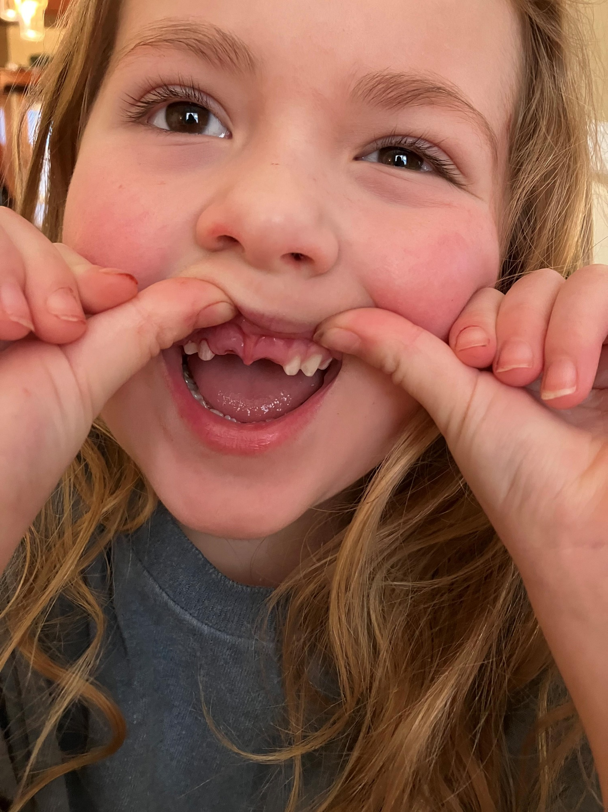

Slide 30


HOW MUCH ADDED SUGAR IS RECOMMENDED FOR A:
12 MONTH OLD
18 MONTH OLD
24 MONTH OLD

Slide 31
EVERY BITE COUNTS:
NO ADDED SUGARS FOR KIDS 24 MONTHS OR YOUNGER!
What is added sugar?
Additional sugars added to processed, packaged food and drinks while they are being made or at your table.
Added sugar is easier to spot on nutrition labels. You also can find added sugar by reading the ingredients. It comes in many forms, including brown sugar, corn sweetener, corn syrup, high-fructose corn syrup, honey dextrose, fruit juice concentrates, invert sugar, malt sugar, molasses, raw sugar, turbinado and ingredients ending in “-ose.”
Why avoid added sugars?
Eating and drinking too much added sugar puts kids at risk for obesity, tooth decay, heart disease, high cholesterol, high blood pressure, type 2 diabetes and fatty liver disease, among other health problems, according to the American Academy of Pediatrics (AAP).
Dietary Guidelines Advisory Committee. 2020. Scientific Report of the 2020 Dietary Guidelines Advisory Committee: Advisory Report to the Secretary of Agriculture and the Secretary of Health and Human Services. U.S. Department of Agriculture, Agricultural Research Service, Washington, DC.

Slide 32
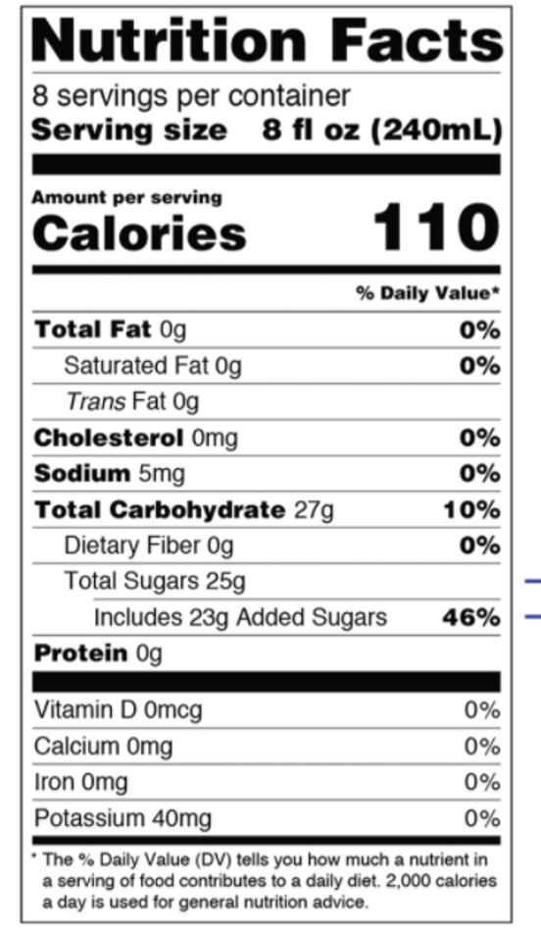

EVERY BITE COUNTS:
No added sugars for kids 24 months or younger!

Slide 33

NO JUICE FOR ANYONE UNDER
12 MONTHS SAYS AAP!
BIRTH TO 1 YEAR OLD
• NO JUICE UNLESS PRESCRIBED BY PEDIATRICIAN
1 - 3 YEARS OLD
• 4 ounces daily maximum to be taken with a snack or meal
• Never put juice in a sippy cup or bottle
4 – 6 YEARS OLD
• 4 – 6 ounces daily maximum to be taken with a snack or meal
• Never put juice in a sippy cup or bottle
7 – 18 YEARS OLD
• Limited to 8 ounces or 1 cup of the recommended 2 - 2.5 cups of fruit servings per day

Slide 34
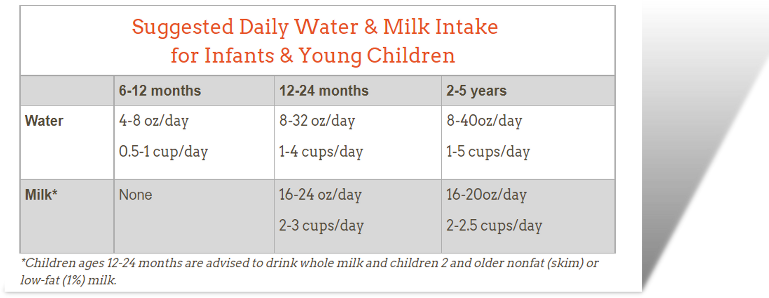
https://www.healthychildren.org/English/healthy-living/nutrition/Pages/Recommended-Drinks-for-Young-Children-Ages-0-5.aspx

Slide 35


The Pediatric Dentist's Guide to Food and Drink Choices for School and Daycare
DR. TAMMY BUTTON, PEDIATRIC DENTIST/HOUSEHOLD LUNCH AND SNACK PREPARER

Slide 36
First 1000 days of Life
The most critical time to effectively prevent dental caries is during pregnancy and the first six months of life
Pregnancy: 280 days
First six months: 180 days
Total: 460 days
Age 1 Dental Visit: 640 days – 820 days
Abanto, Jenny et. Al.: Impact of the first thousand days of life on dental caries through the life course: a transdisciplinary approach. Braz. Oral Res. 2022; 36:e113.

Slide 37
Objectives:
Illustrate the critical importance of oral health during the first 1,000 days of life and its impact on long-term oral health outcomes
Explore effective community-based strategies to promote oral health among pregnant individuals and infants, emphasizing culturally responsive approaches
Discuss the role of interdisciplinary collaboration in integrating oral health education and services into community health programs to enhance access and equity.

Slide 38



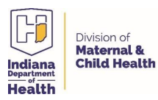


Slide 39


WHAT IS HEALTHY FAMILIES?

Slide 40

Nationally accredited home visitation program that nurtures the parent-child relationship to promote child well-being and prevent adverse childhood experiences (ACEs)
Healthy Families serves families prenatally or with a child less than 90 days old
Children may remain in the program until age 5

Slide 41
Indiana Department of Health Division of Maternal & Child Health
Title V Block Grant
Goal 1: Promote optimal dental health for expectant mothers and children from birth to 5 years.
Objective 1: Deliver oral health education and oral health kits at prescribed intervals to 100% of expectant mothers and children participating in Healthy Families LaPorte County.
Objective 2: 95% of participating families self-report increased understanding of proper oral health during pregnancy and childhood, promote and practice healthy oral hygiene within the family and gain increased comfort with and access to a dentist.

Slide 42

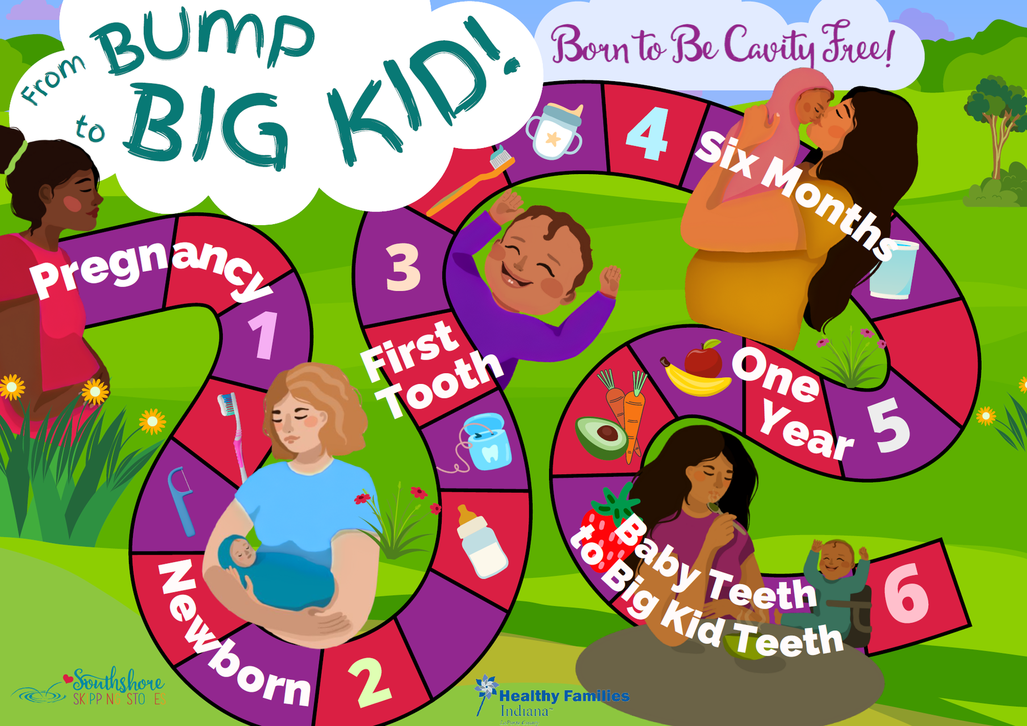

Slide 43
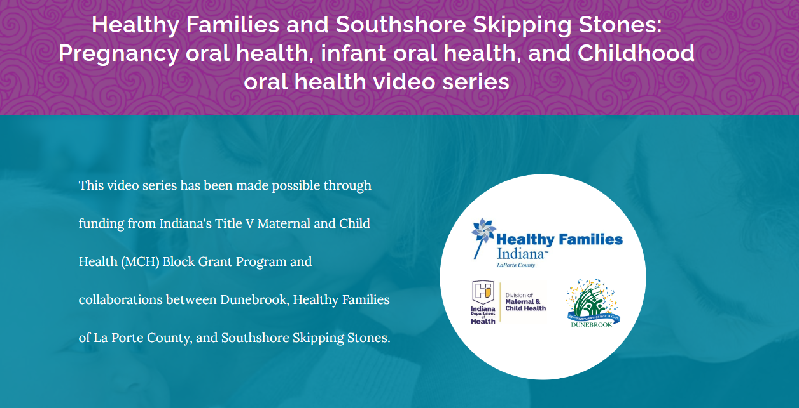

Slide 44
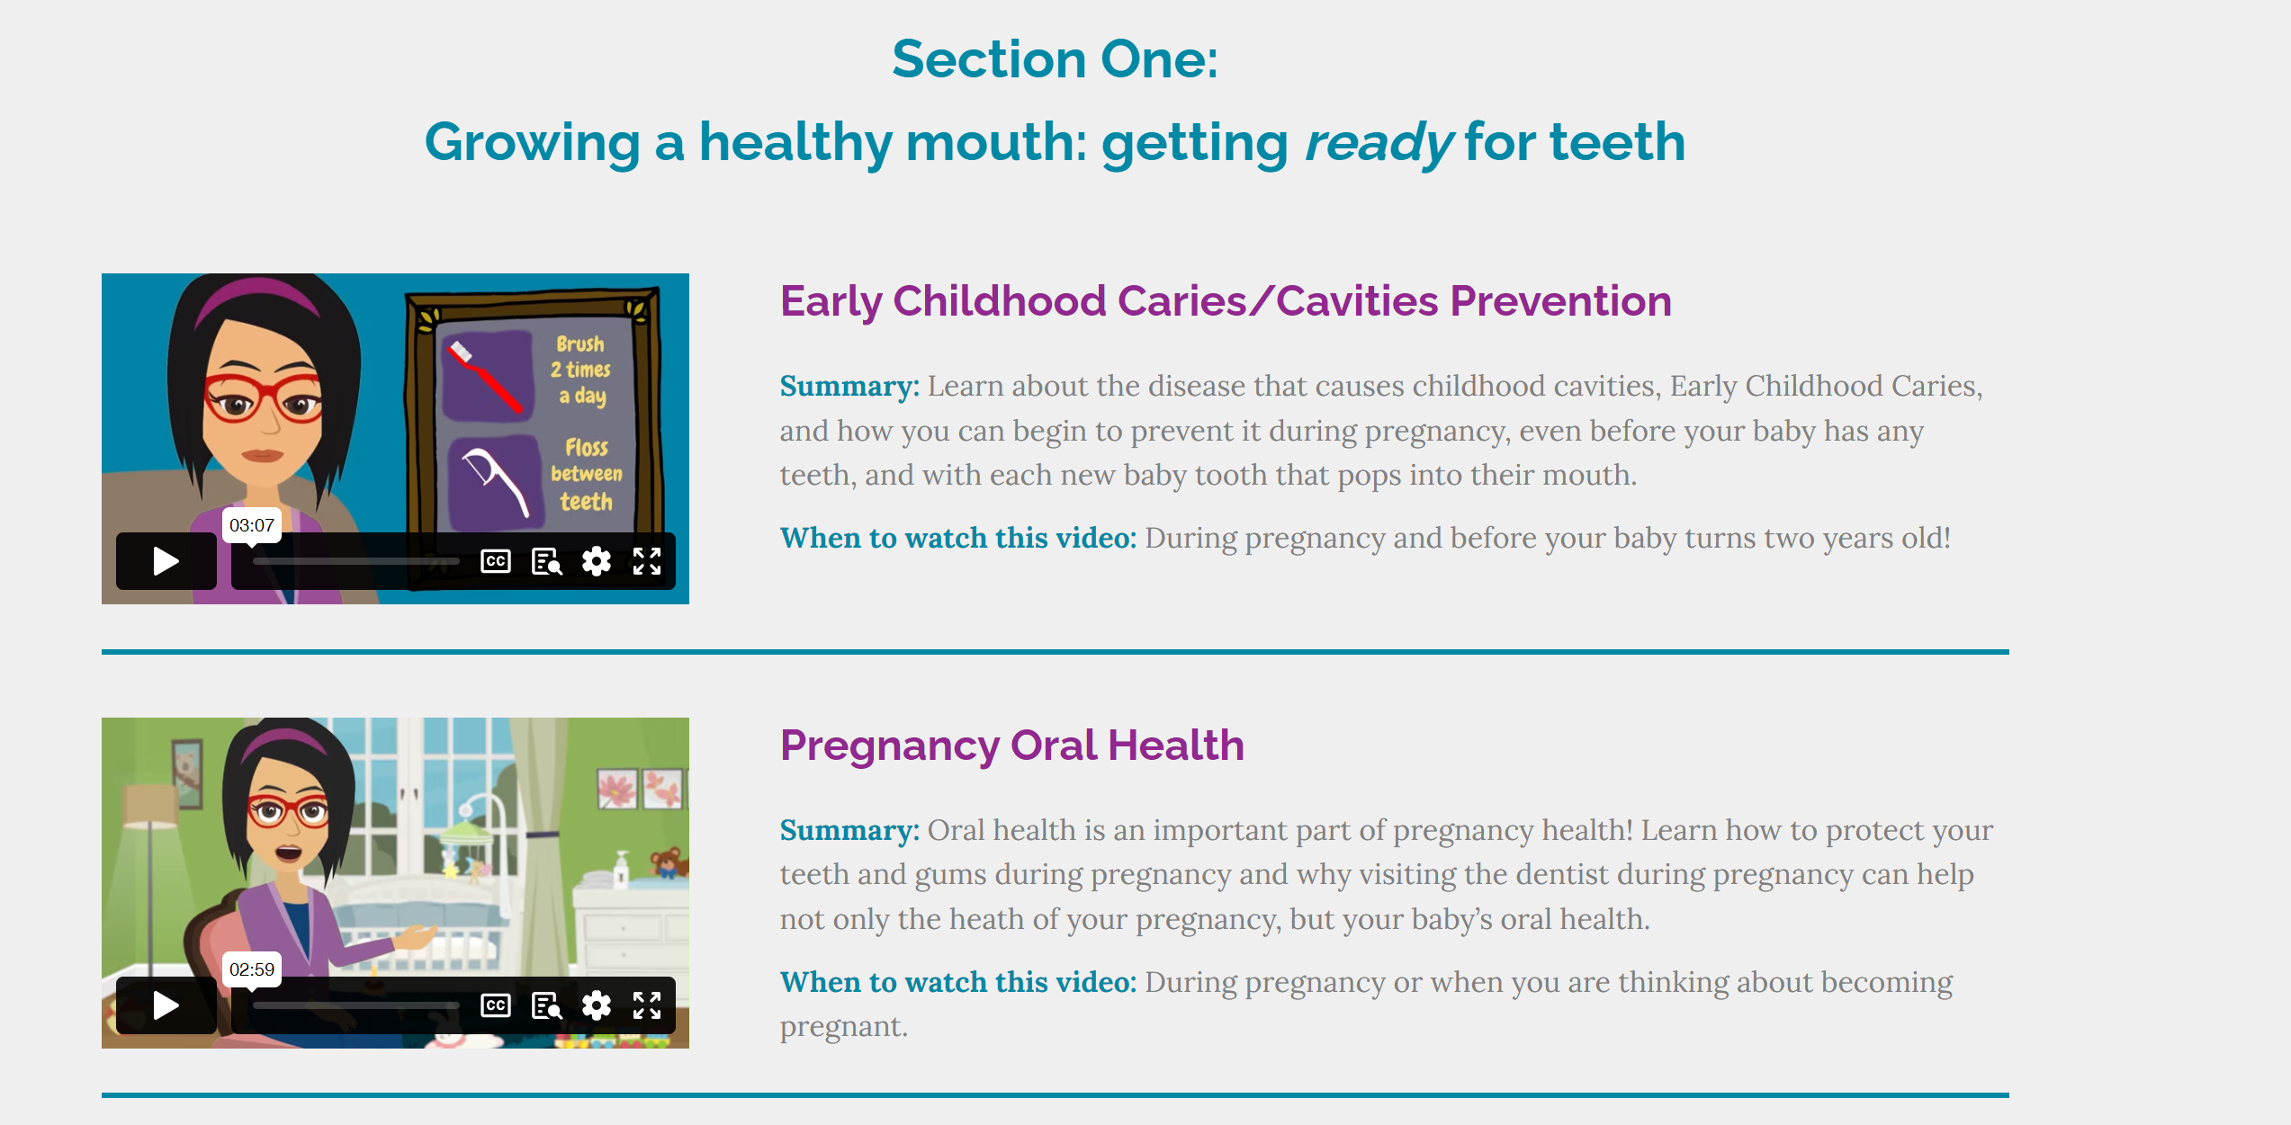

Slide 45
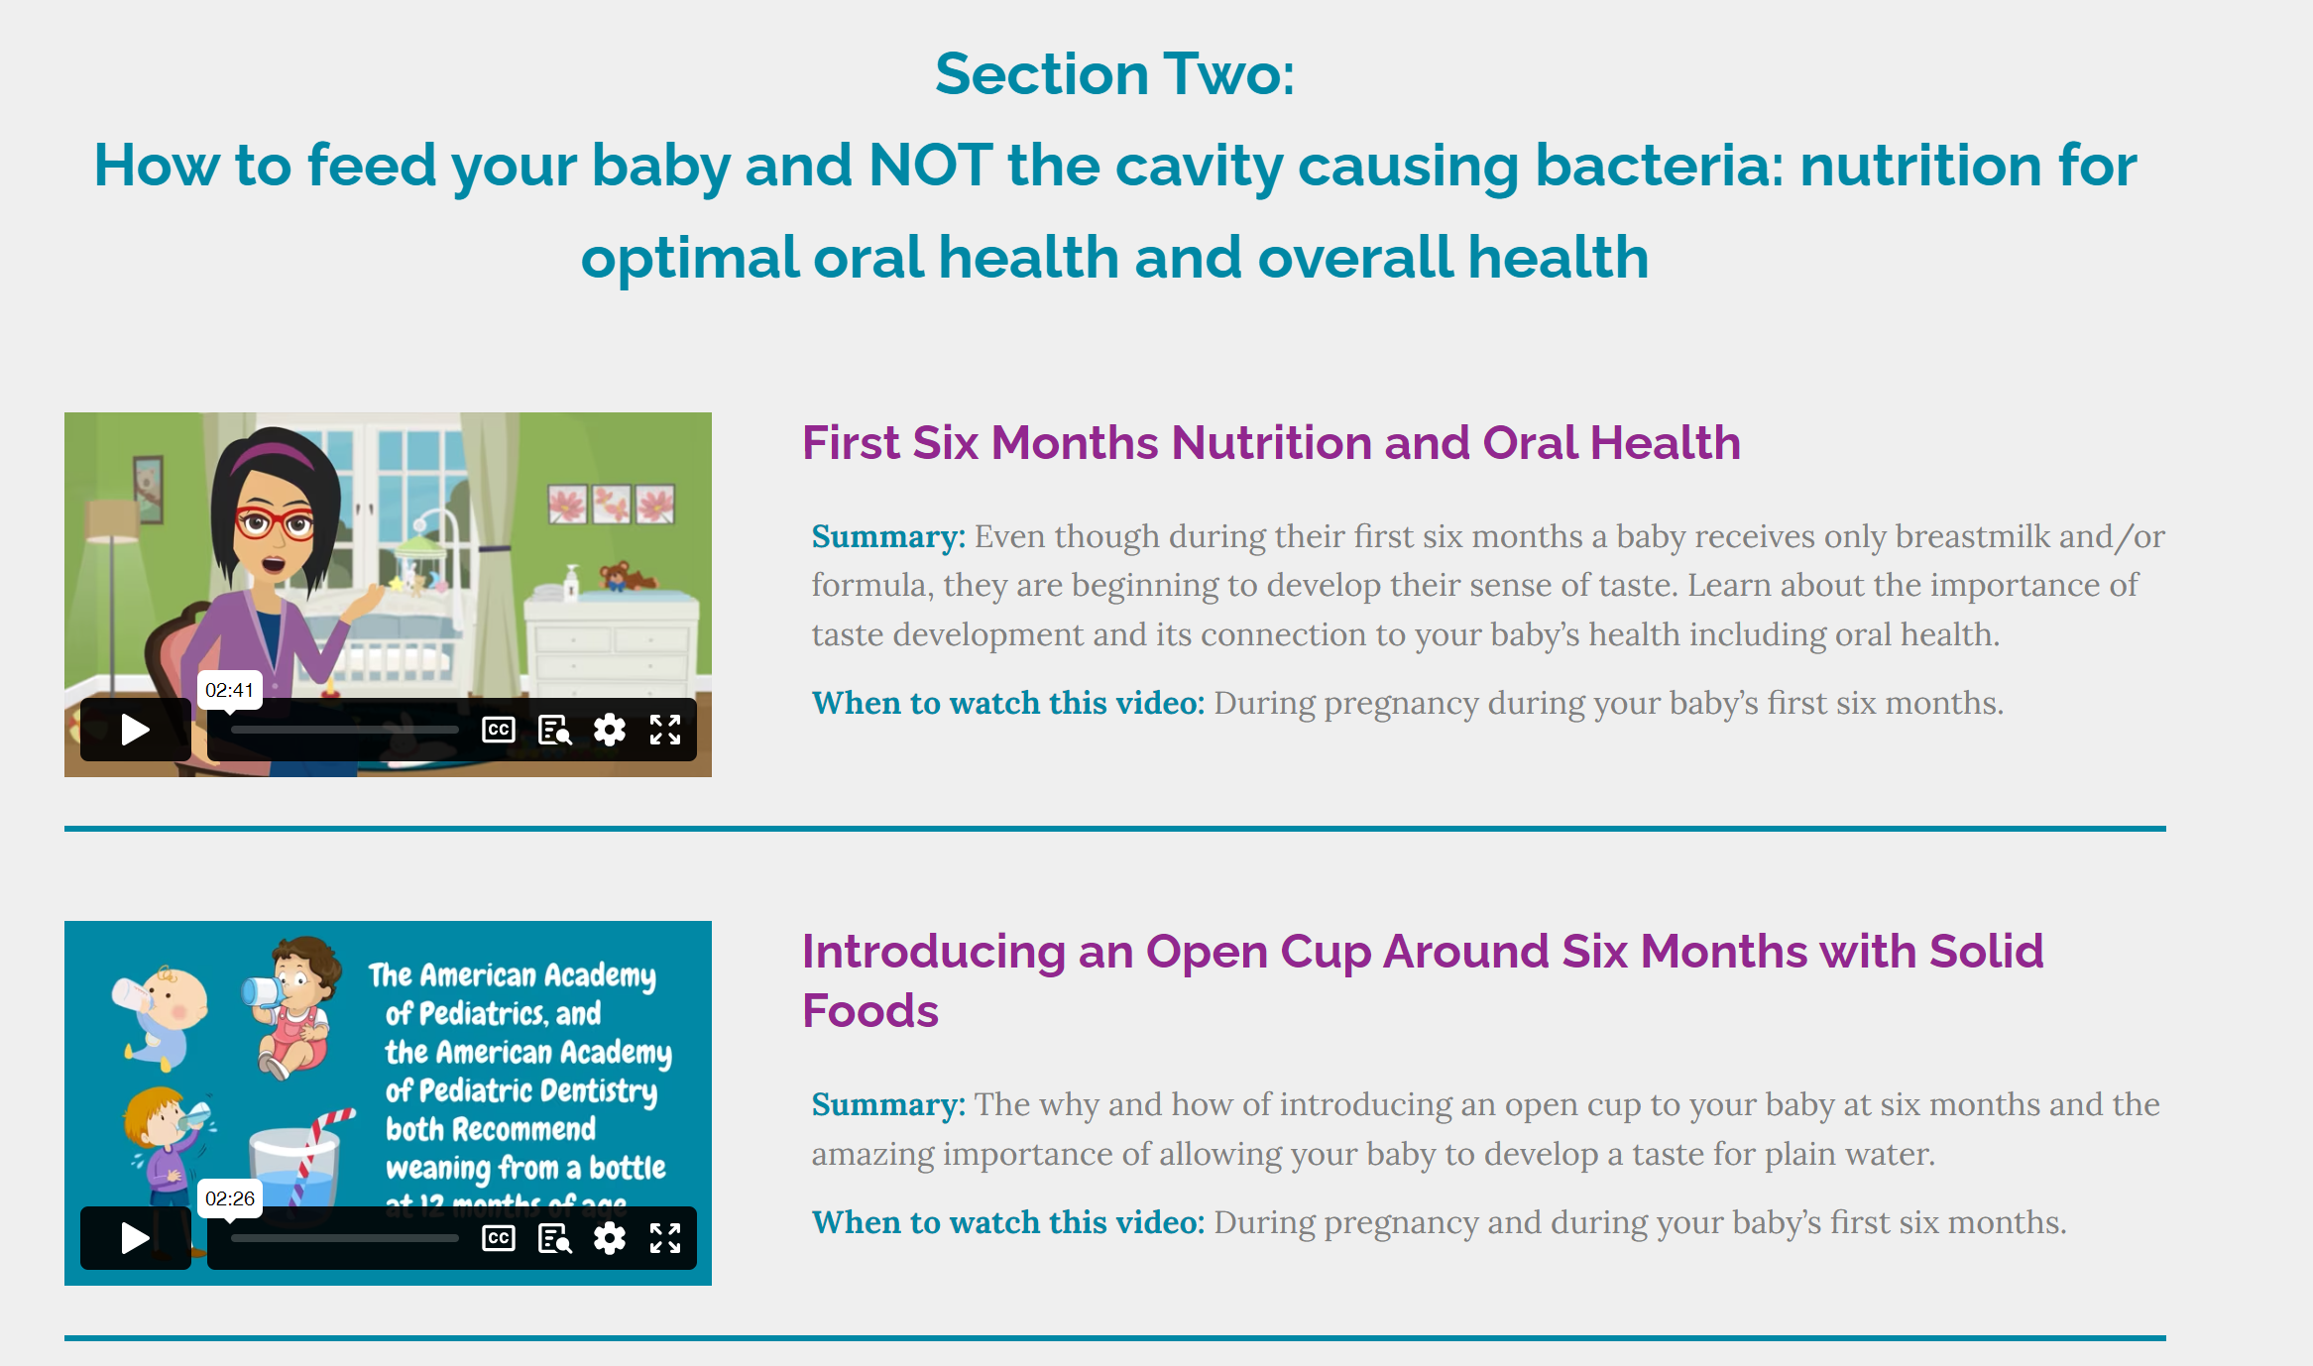

Slide 46

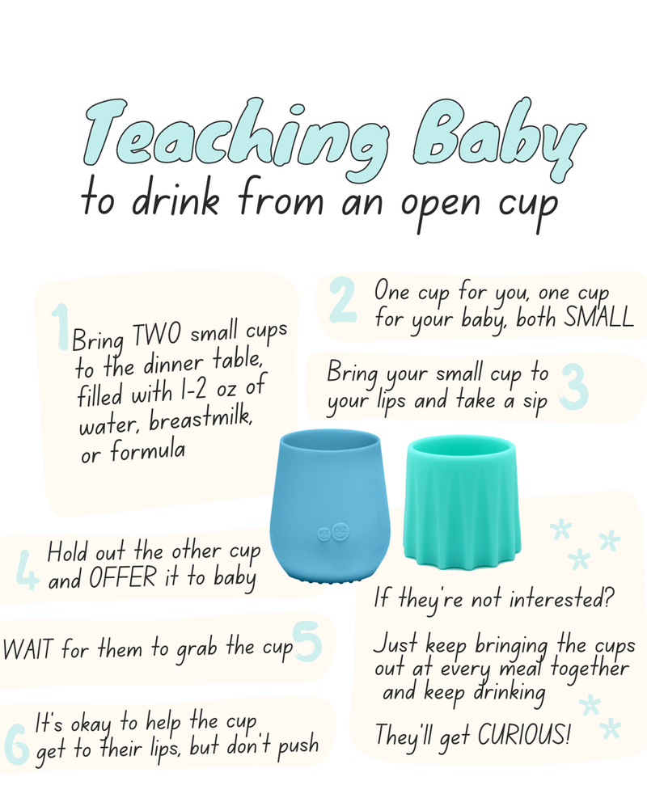
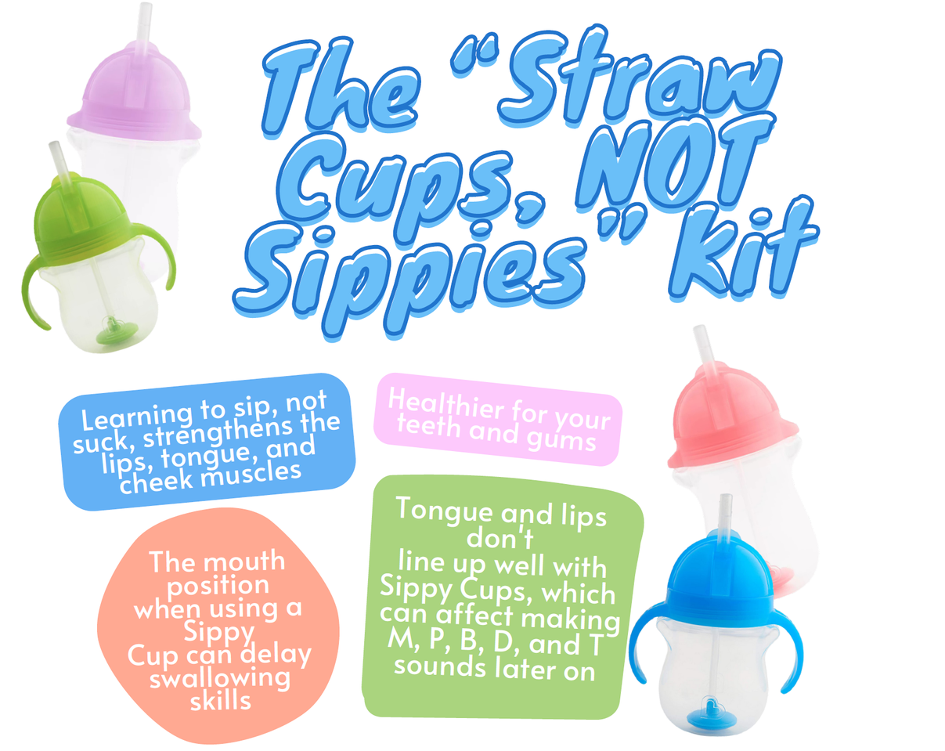

Slide 47


Slide 48
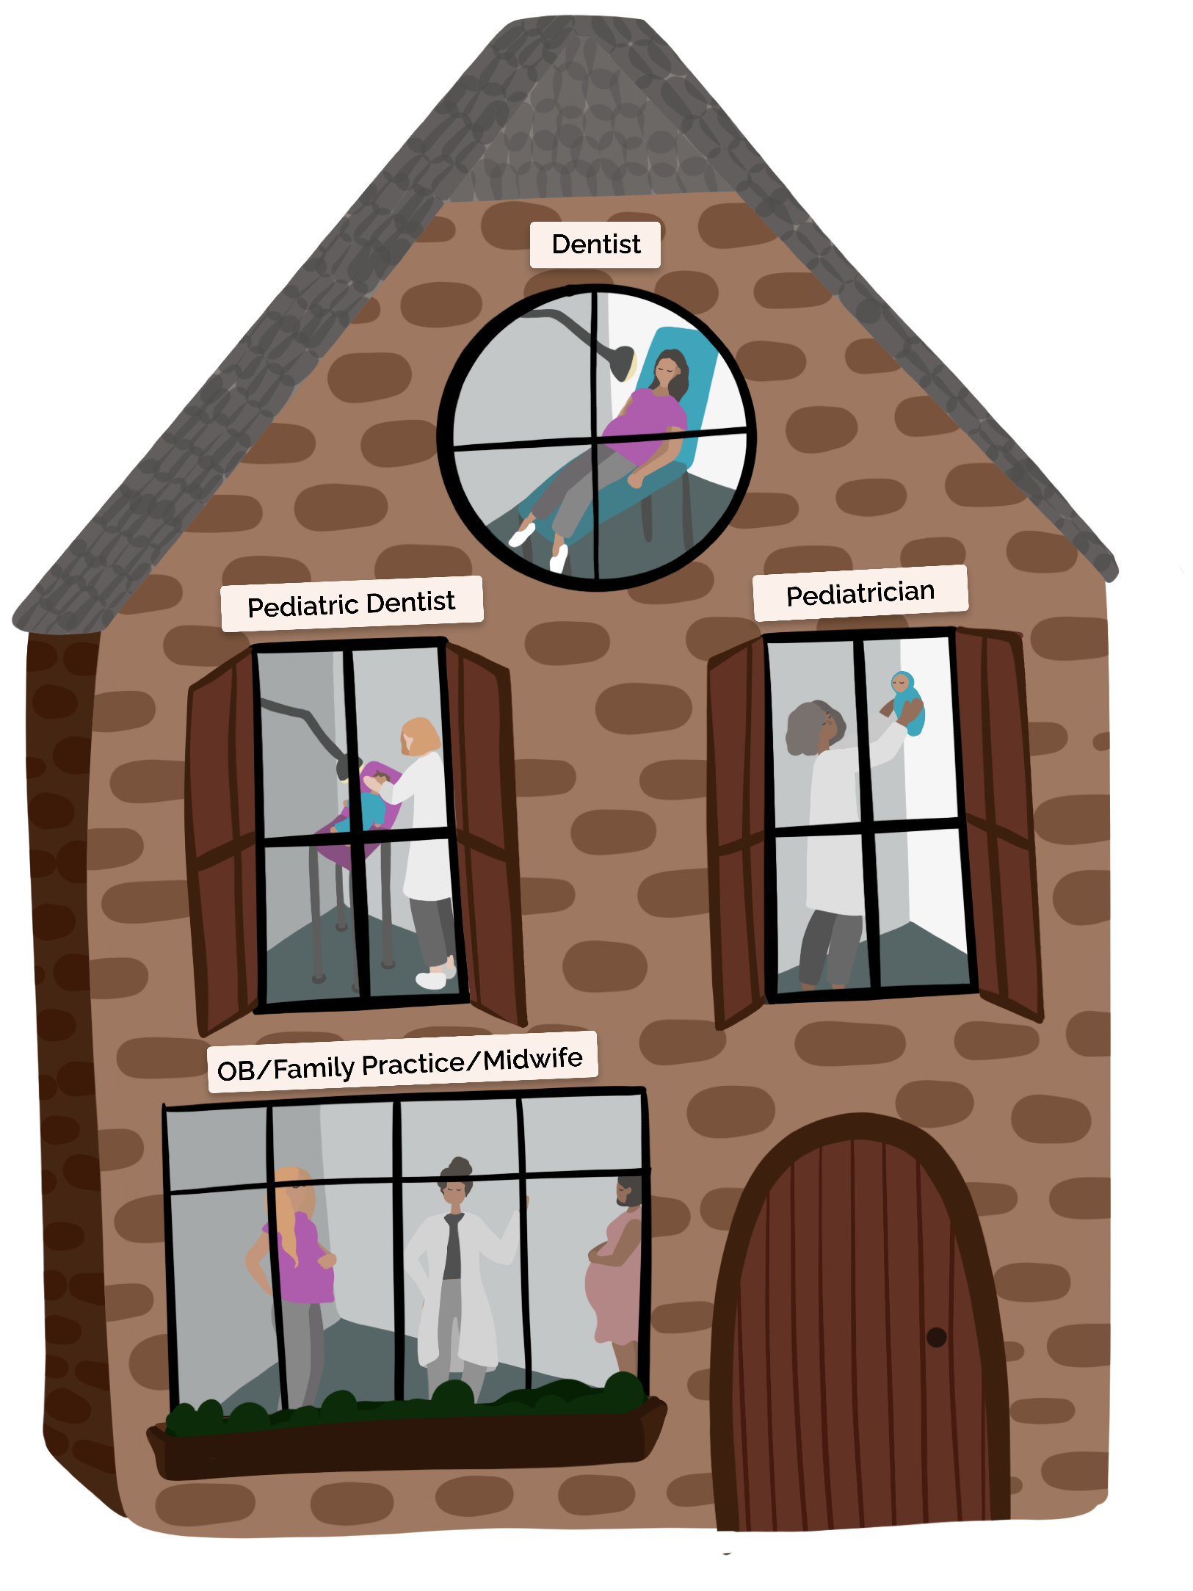

Slide 49

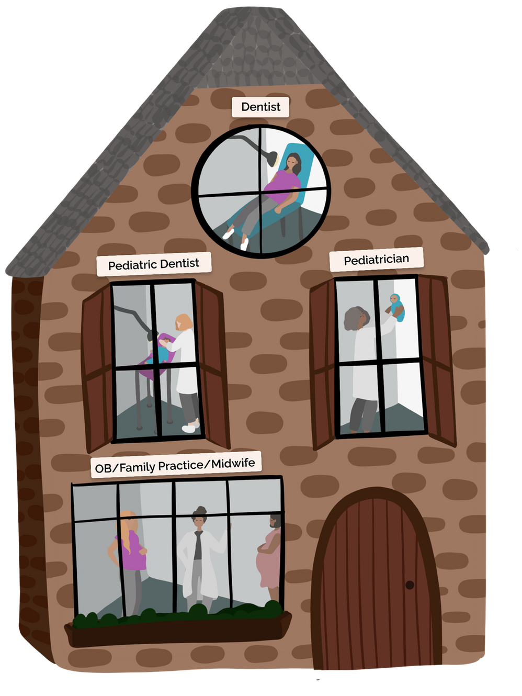


Community Health Workers
Promatoras
Home Visitors

Slide 50

Dr. Ta
Dr. Tammy Gierke Button
tammy@dunebrook.org
(317) 417 5376

